Slide 1
Rearranging The Deck Chairs on The Titanic
James Paine
May 6, 2022

Slide 2
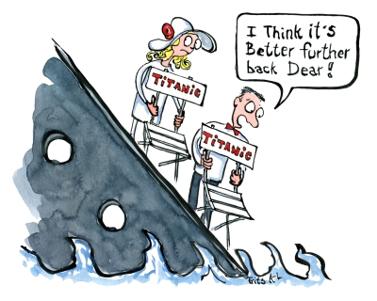
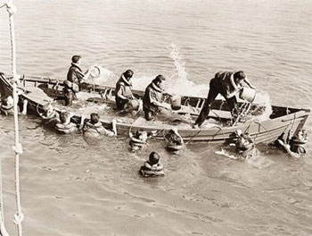

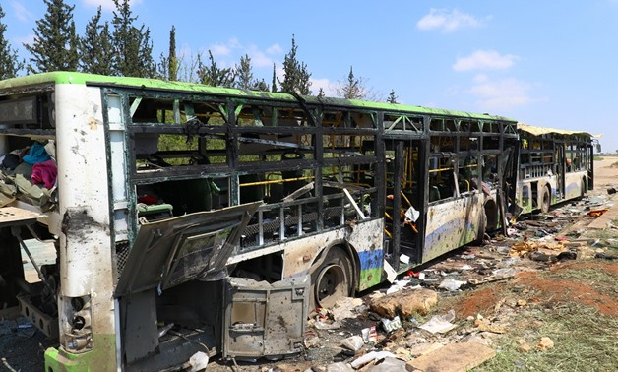
Problem Articulation
The phrase “Rearranging the deck chairs on the Titanic is typically used metaphorically in the sense of “to occupy oneself with some trivial activity while ignoring something much more important.”
During an actively unfolding crisis, the ability to identify activities as ‘trivial’ versus essential can be unclear, and some activities could actively prevent a crisis or even recover from it.
Aside from prevention and mitigation, people can also evacuate from a crisis.
But not necessarily successfully.
Under what circumstances could “rearranging the deck chairs” or any possibly preventative activity during a crisis have been helpful in reducing deaths?
How can the actions of the people during an evolving and crisis materially affect the both the physical and behavioral dynamics of the crisis, and how do you balance those actions with the immediate value of fleeing?
Frits Ahlefeldt – “The Hiking Artist”
Martha's Vineyard Museum
zeenews.india.com
egypttoday.com

Slide 3


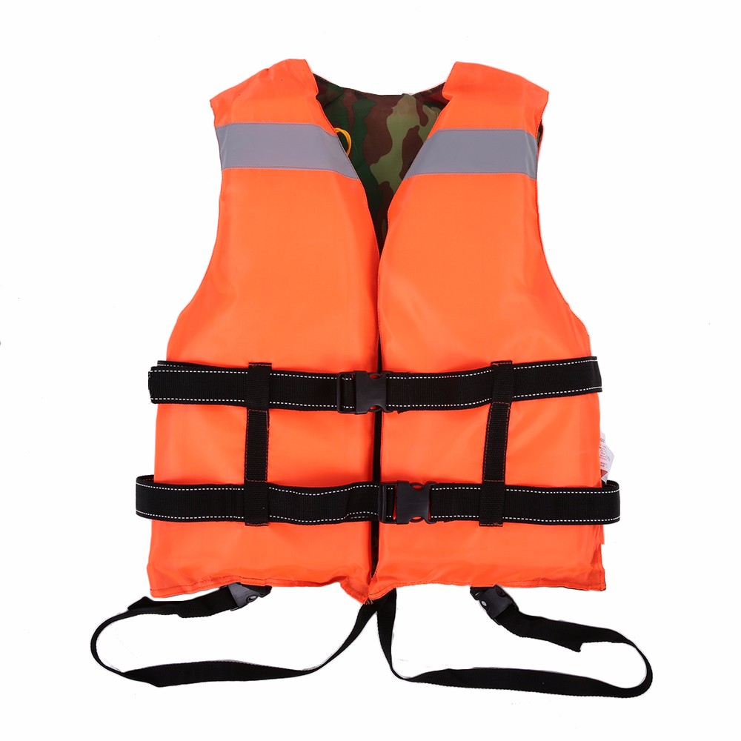
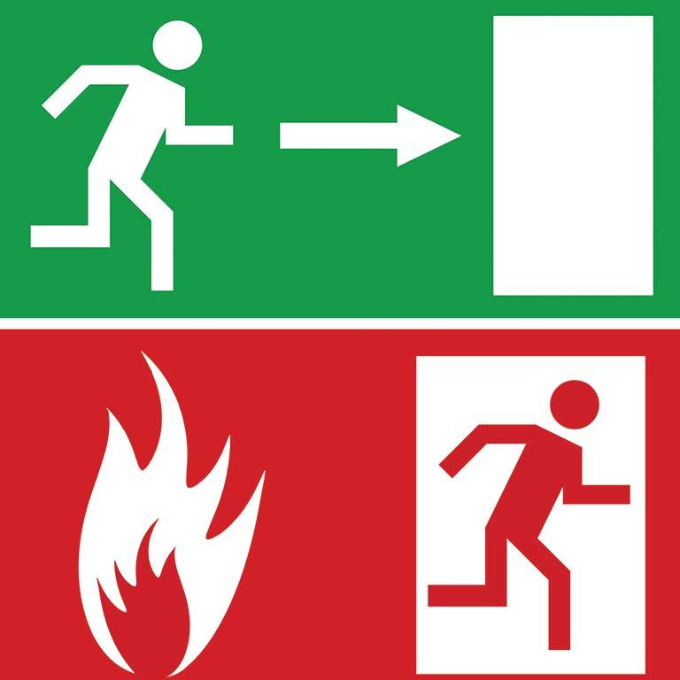


Dynamic Hypothesis
An exogenous event kicks off a crisis that actively erodes a system’s ability to support life. If a critical lower threshold is passed, it will spell doom for those still exposed to danger.
Those in this eroding system have three options with their limited time:
Do nothing
Work to mitigate the crisis, possibly buying time (or even preventing or reversing further degradation of the situation)
Flee (evacuate)
Fleeing has the immediate effect of removing people from harm...
Though it may be inefficient, resulting in more harm than good
Concentrating effort on one path reduces effort available for the others
Concern for Safety is a function perception of the current capability to resist the crisis, and also perception of activities around each person. Evacuation is stressful, while mitigation actives are less so (or even calming)
Low levels of concern will increase efficacy of evacuation efforts
High levels of concern lead to panic and less efficacious evacuation
Notes:
Capability Traps again!

Slide 4
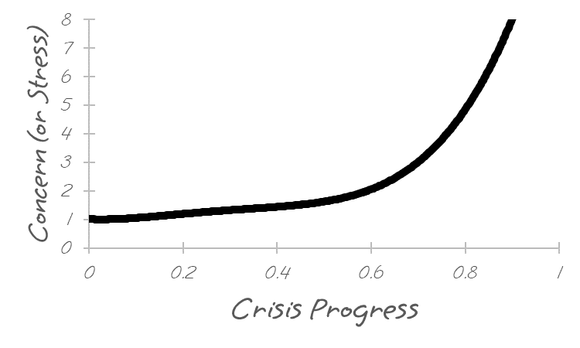
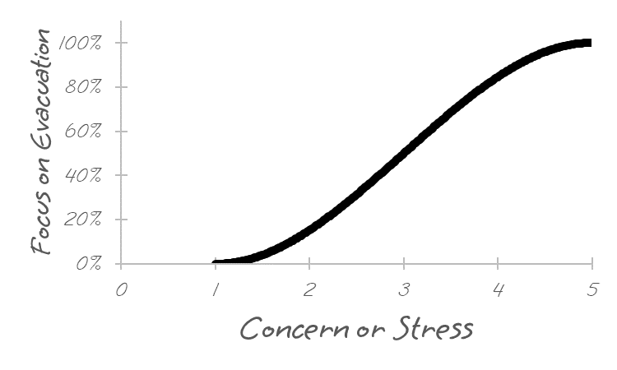
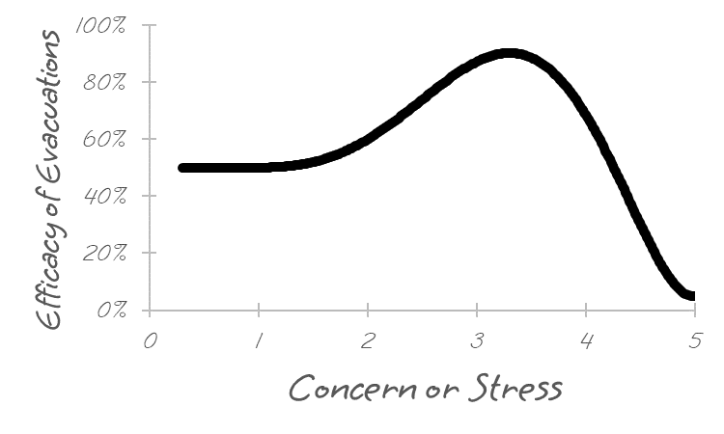
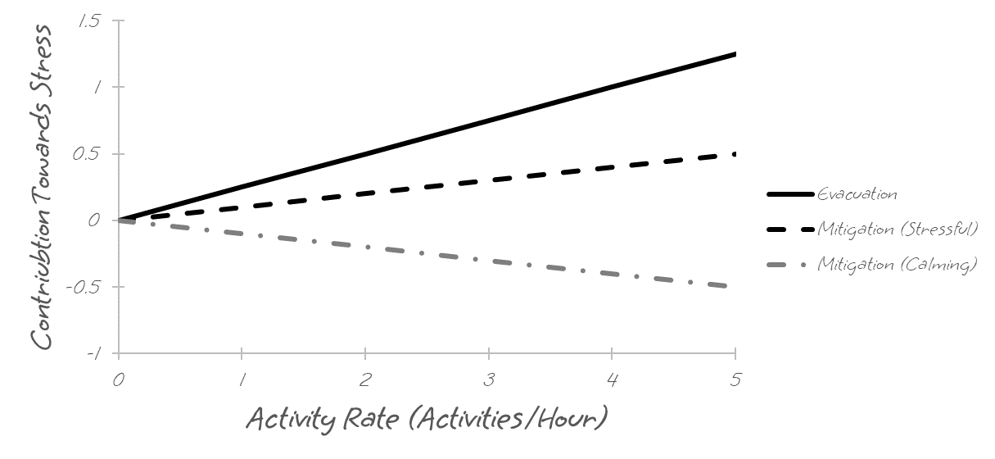
Reference Modes
Notes:
Capability Traps again!

Slide 5
Key Variables, Stocks and Flows
Variable | Units | Category
Concern for Safety | Dmnl | Stock
Capability to Resist Crisis | Dmnl | Stock
People exposed to Crisis | People | Stock
Evacuated (Survived) | People/Hour | Flow
Evacuated (Died) | People/Hour | Flow
Notes:
Emphasize that I’m trying to keep this simple

Slide 6
Capturing Effect of Activities on Stress (Concern for Safety)
Concern for Safety
Increases as crisis develops and fraction of time left begins to drop
Affected by perception of crisis mitigation activities going one
Assume that seeing evacuations will only drive up concern
Polarity of Loop through Mitigation Efforts can be Reinforcing OR Balancing
Reinforcing if sign on Effect is (+)
Balancing if sign on Effect is (-)
E.g. ‘calming’ to see mitigation happening during crisis

Slide 7
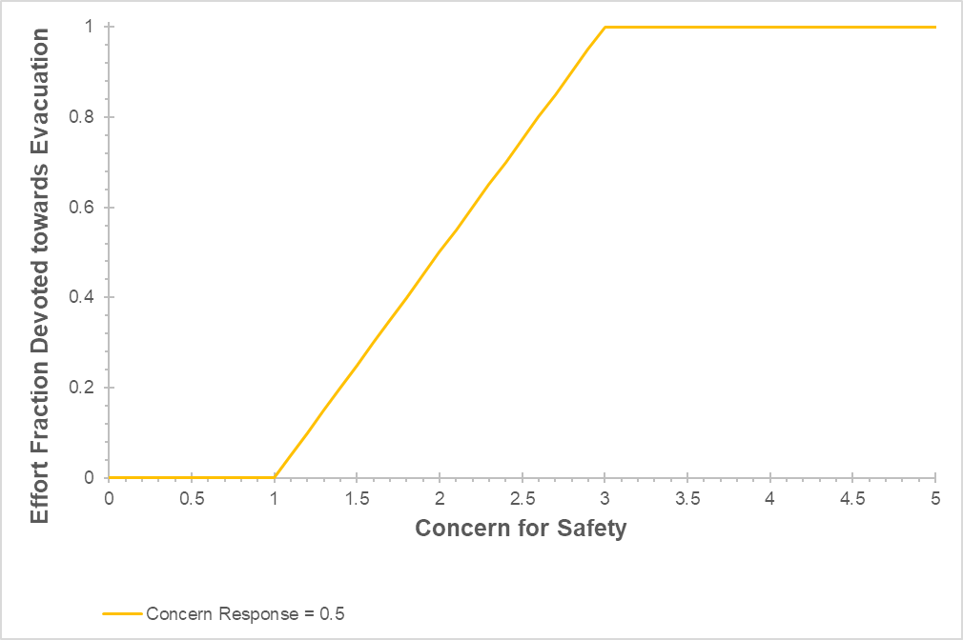
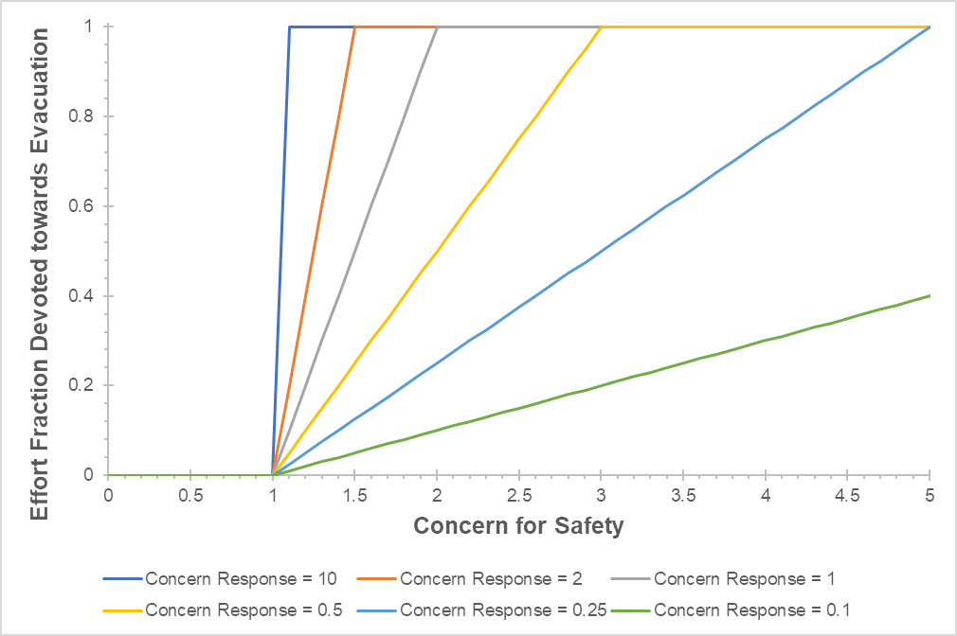
Capturing Effect of Activities on Stress (Concern for Safety)

Slide 8
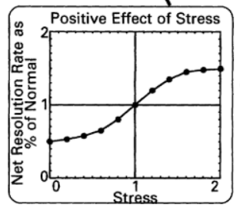
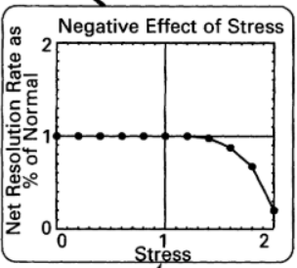
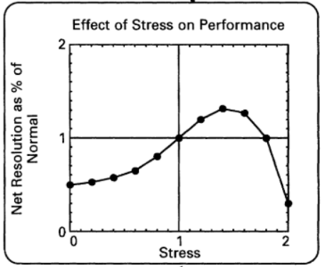
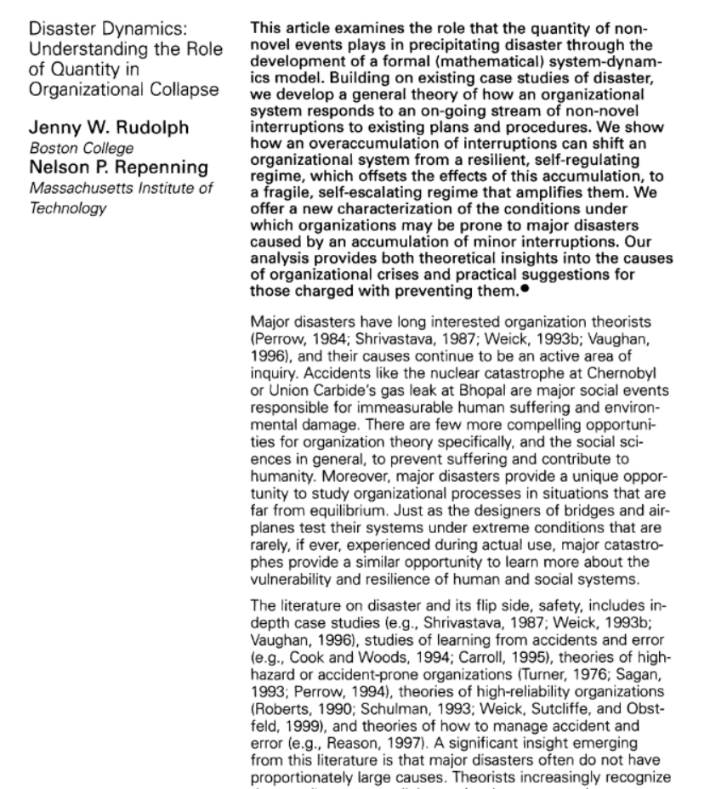
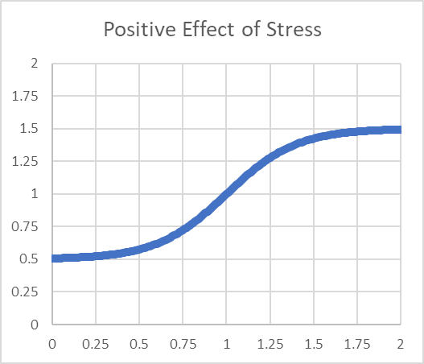
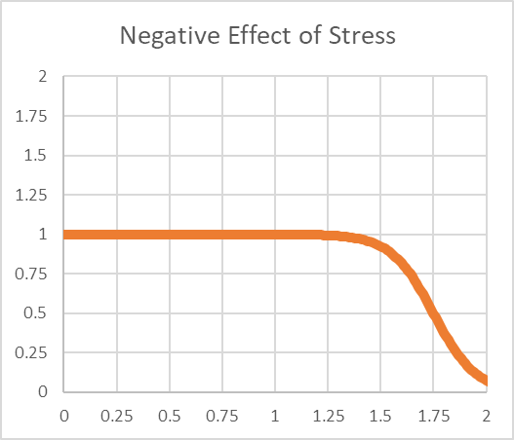
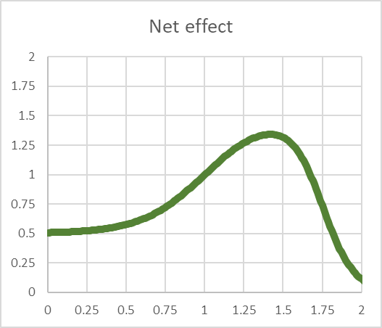
Capturing Effect of Stress on Performance
X
=
X
=

Slide 9
Capturing Effect of Stress on Performance

Slide 10
Evacuation Efficacy is affected by Stress
Evacuation is NOT assumed to be successful
Efficacy of Evacuation Efforts Affected by Concern (stress)
Efficacy of evacuation efforts affects what fraction of evacuations are successful

Slide 11
Capability to Manage (Resist) a Crisis
Mitigation Activities Can Improve Capability
“Rearranging the Deck Chairs” would have low to no build on capability, but some other activities might help!
Perception of capability to resist crisis affects level of concern and how much idle time is spent in mitigation activities
Crisis progression erodes capability, but mitigation and rebuild it!
Capability here could also be ‘System Capability to Support Life’ or even directly operationalized e.g. ‘Feet above Waterline’ for a ship
Notes:
Different name here?

Slide 12
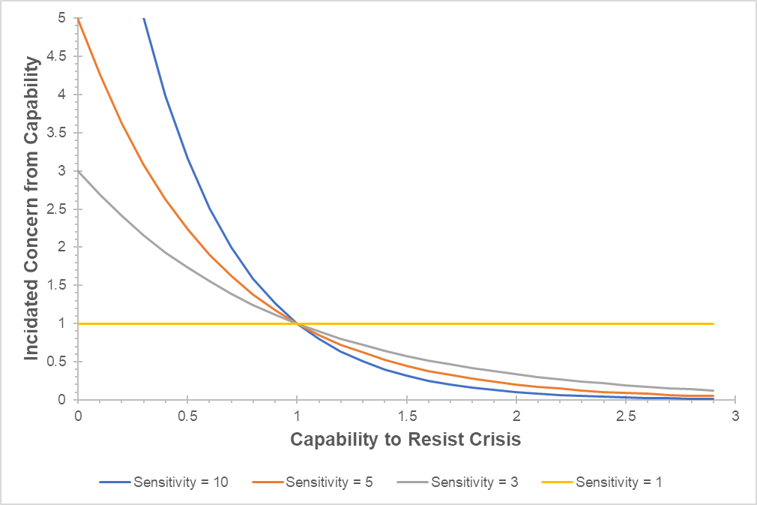
Capability under Crisis
Notes:
Different name here?

Slide 13
Full Combined Model
One more way to exit the system
Assume that below a critical capability, people start rapidly dying
Notes:
Different name here?

Slide 14
Exploring Dynamic Behavior
Parameter | Baseline Value | Units
Activity Rate | 1 | Activities/Person/Hour
Avg Time for Death Under Crisis | 1 | Hour
Baseline Capability | 1 | Dmnl
Baseline Efficacy of Evacuation Activities | 0.5 | Dmnl
Capability Gap Sensitivity | 1 | Dmnl
Concern Response Sensitivity | 0.05 | Dmnl
Crisis Progression Rate | 0.5 | Dmnl/Hour
Crisis Start Time | 10 | Hour
Effect of Viewing Evacuation on Concern for Safety | 0.25 | Dmnl/Activity
Effect of Viewing Mitigation on Concern for Safety | 0.01 | Dmnl/Activity
Effectiveness of Evacuation Activities | 1 | People/Activity
Effectiveness of Mitigation Activities | 0.05 | Dmnl/Activity
Initial | 100 | People
Minimum Evacuation Time | 5 | Minutes
Minimum Viable Capability | 0.01 | Dmnl
Negative Effect K | -10 | Dmnl
Negative Effect X0 | 1.75 | Dmnl
Positive Effect K | 5 | Dmnl
Positive Effect X0 | 1 | Dmnl
Sensitivity of Concern to Capability | 5 | Dmnl
Time to Update Perceptions of Concern | 0.5 | Hour

Slide 15
Exploring Dynamic Behavior
Parameter | Baseline Value | Units
Activity Rate | 1 | Activities/Person/Hour
Avg Time for Death Under Crisis | 1 | Hour
Baseline Capability | 1 | Dmnl
Baseline Efficacy of Evacuation Activities | 0.5 | Dmnl
Capability Gap Sensitivity | 1 | Dmnl
Concern Response Sensitivity | 0.05 | Dmnl
Crisis Progression Rate | 0.5 | Dmnl/Hour
Crisis Start Time | 10 | Hour
Effect of Viewing Evacuation on Concern for Safety | 0.25 | Dmnl/Activity
Effect of Viewing Mitigation on Concern for Safety | 0.01 | Dmnl/Activity
Effectiveness of Evacuation Activities | 1 | People/Activity
Effectiveness of Mitigation Activities | 0.05 | Dmnl/Activity
Initial | 100 | People
Minimum Evacuation Time | 5 | Minutes
Minimum Viable Capability | 0.01 | Dmnl
Negative Effect K | -10 | Dmnl
Negative Effect X0 | 1.75 | Dmnl
Positive Effect K | 5 | Dmnl
Positive Effect X0 | 1 | Dmnl
Sensitivity of Concern to Capability | 5 | Dmnl
Time to Update Perceptions of Concern | 0.5 | Hour
Parameterized semi-realistically
Vary intensity of how fast the crisis erodes the system’s capability to support life
Vary how effective mitigation activities are
>0 but small (effective but weak)
=0 no actual influence on crisis
Also vary behavioral effect of viewing mitigation activities specifically:
>0 (stressing)
<0 (calming)

Slide 16
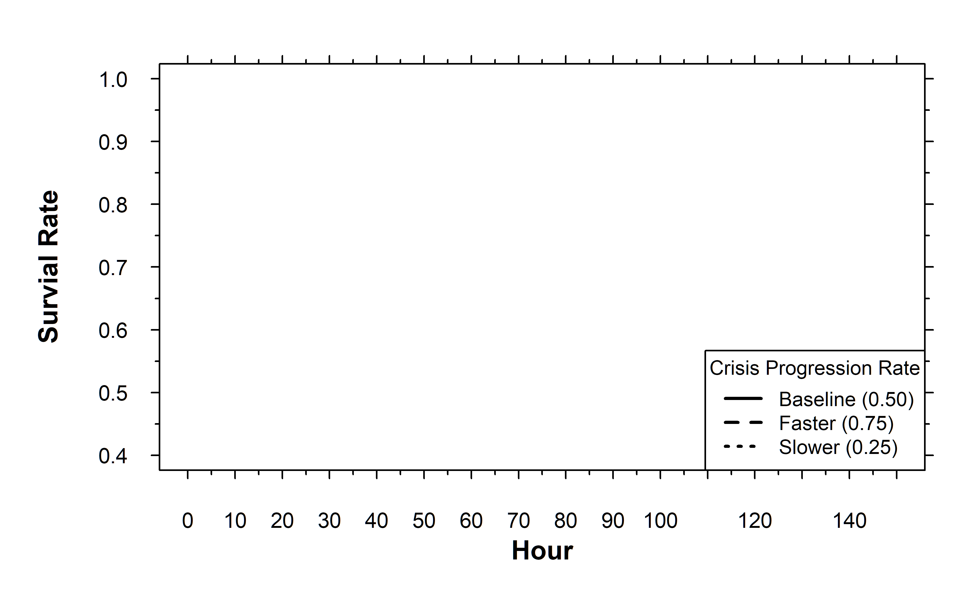
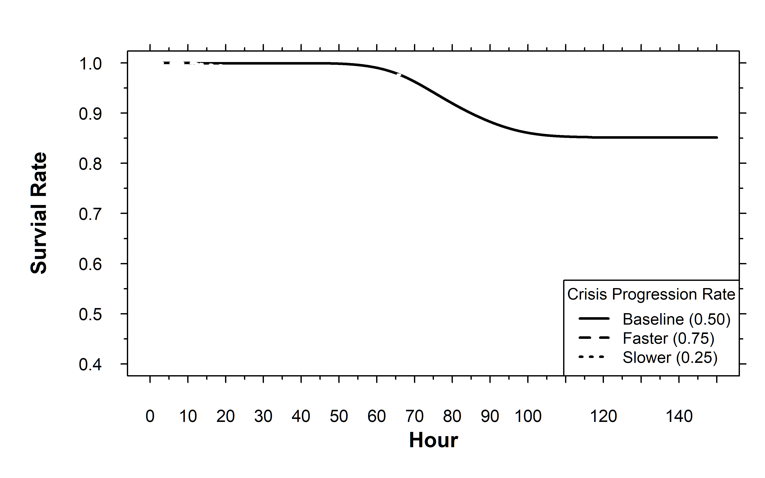
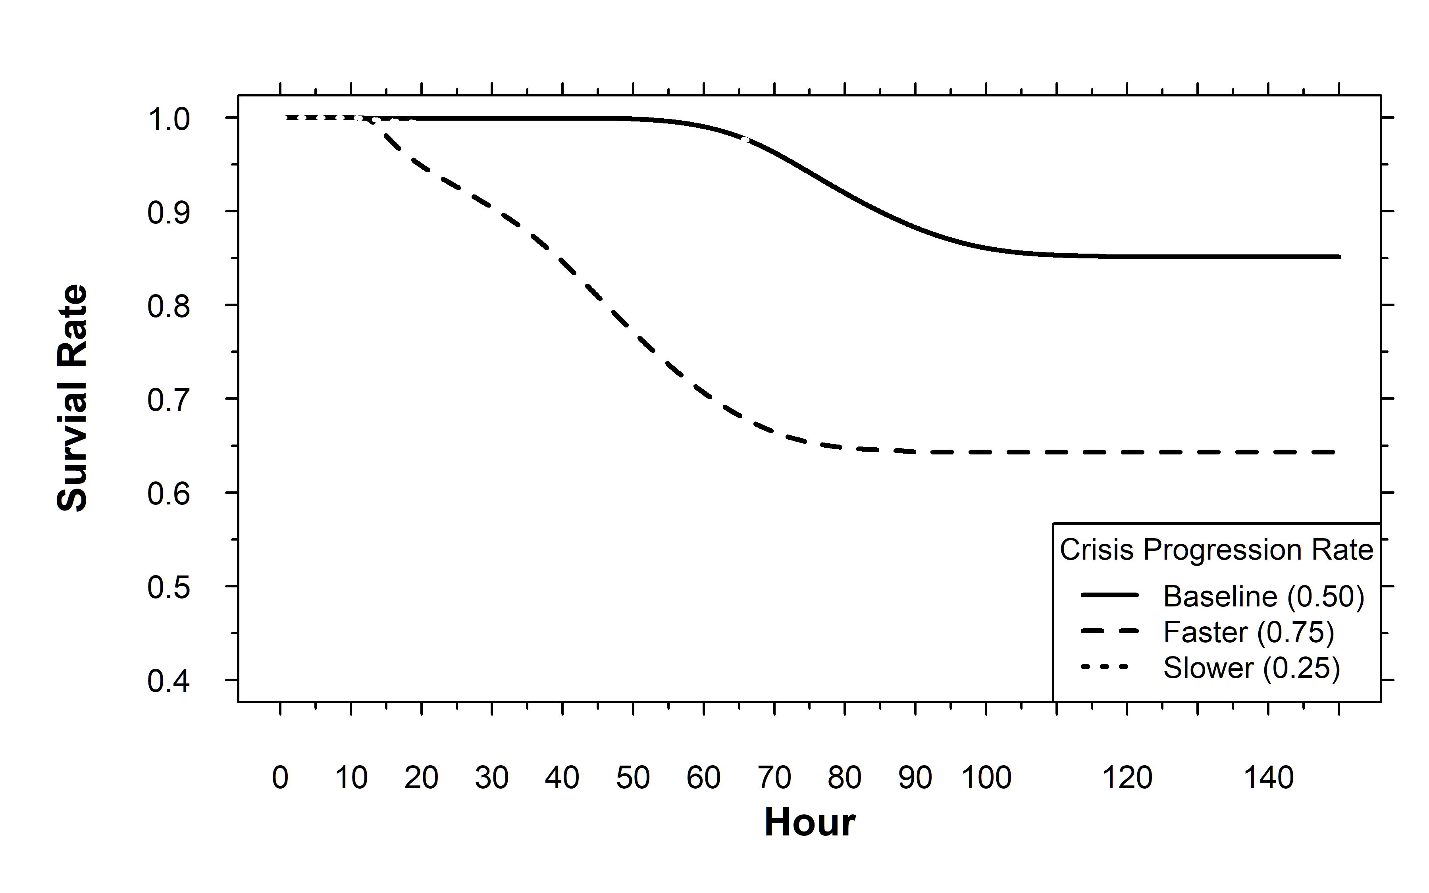
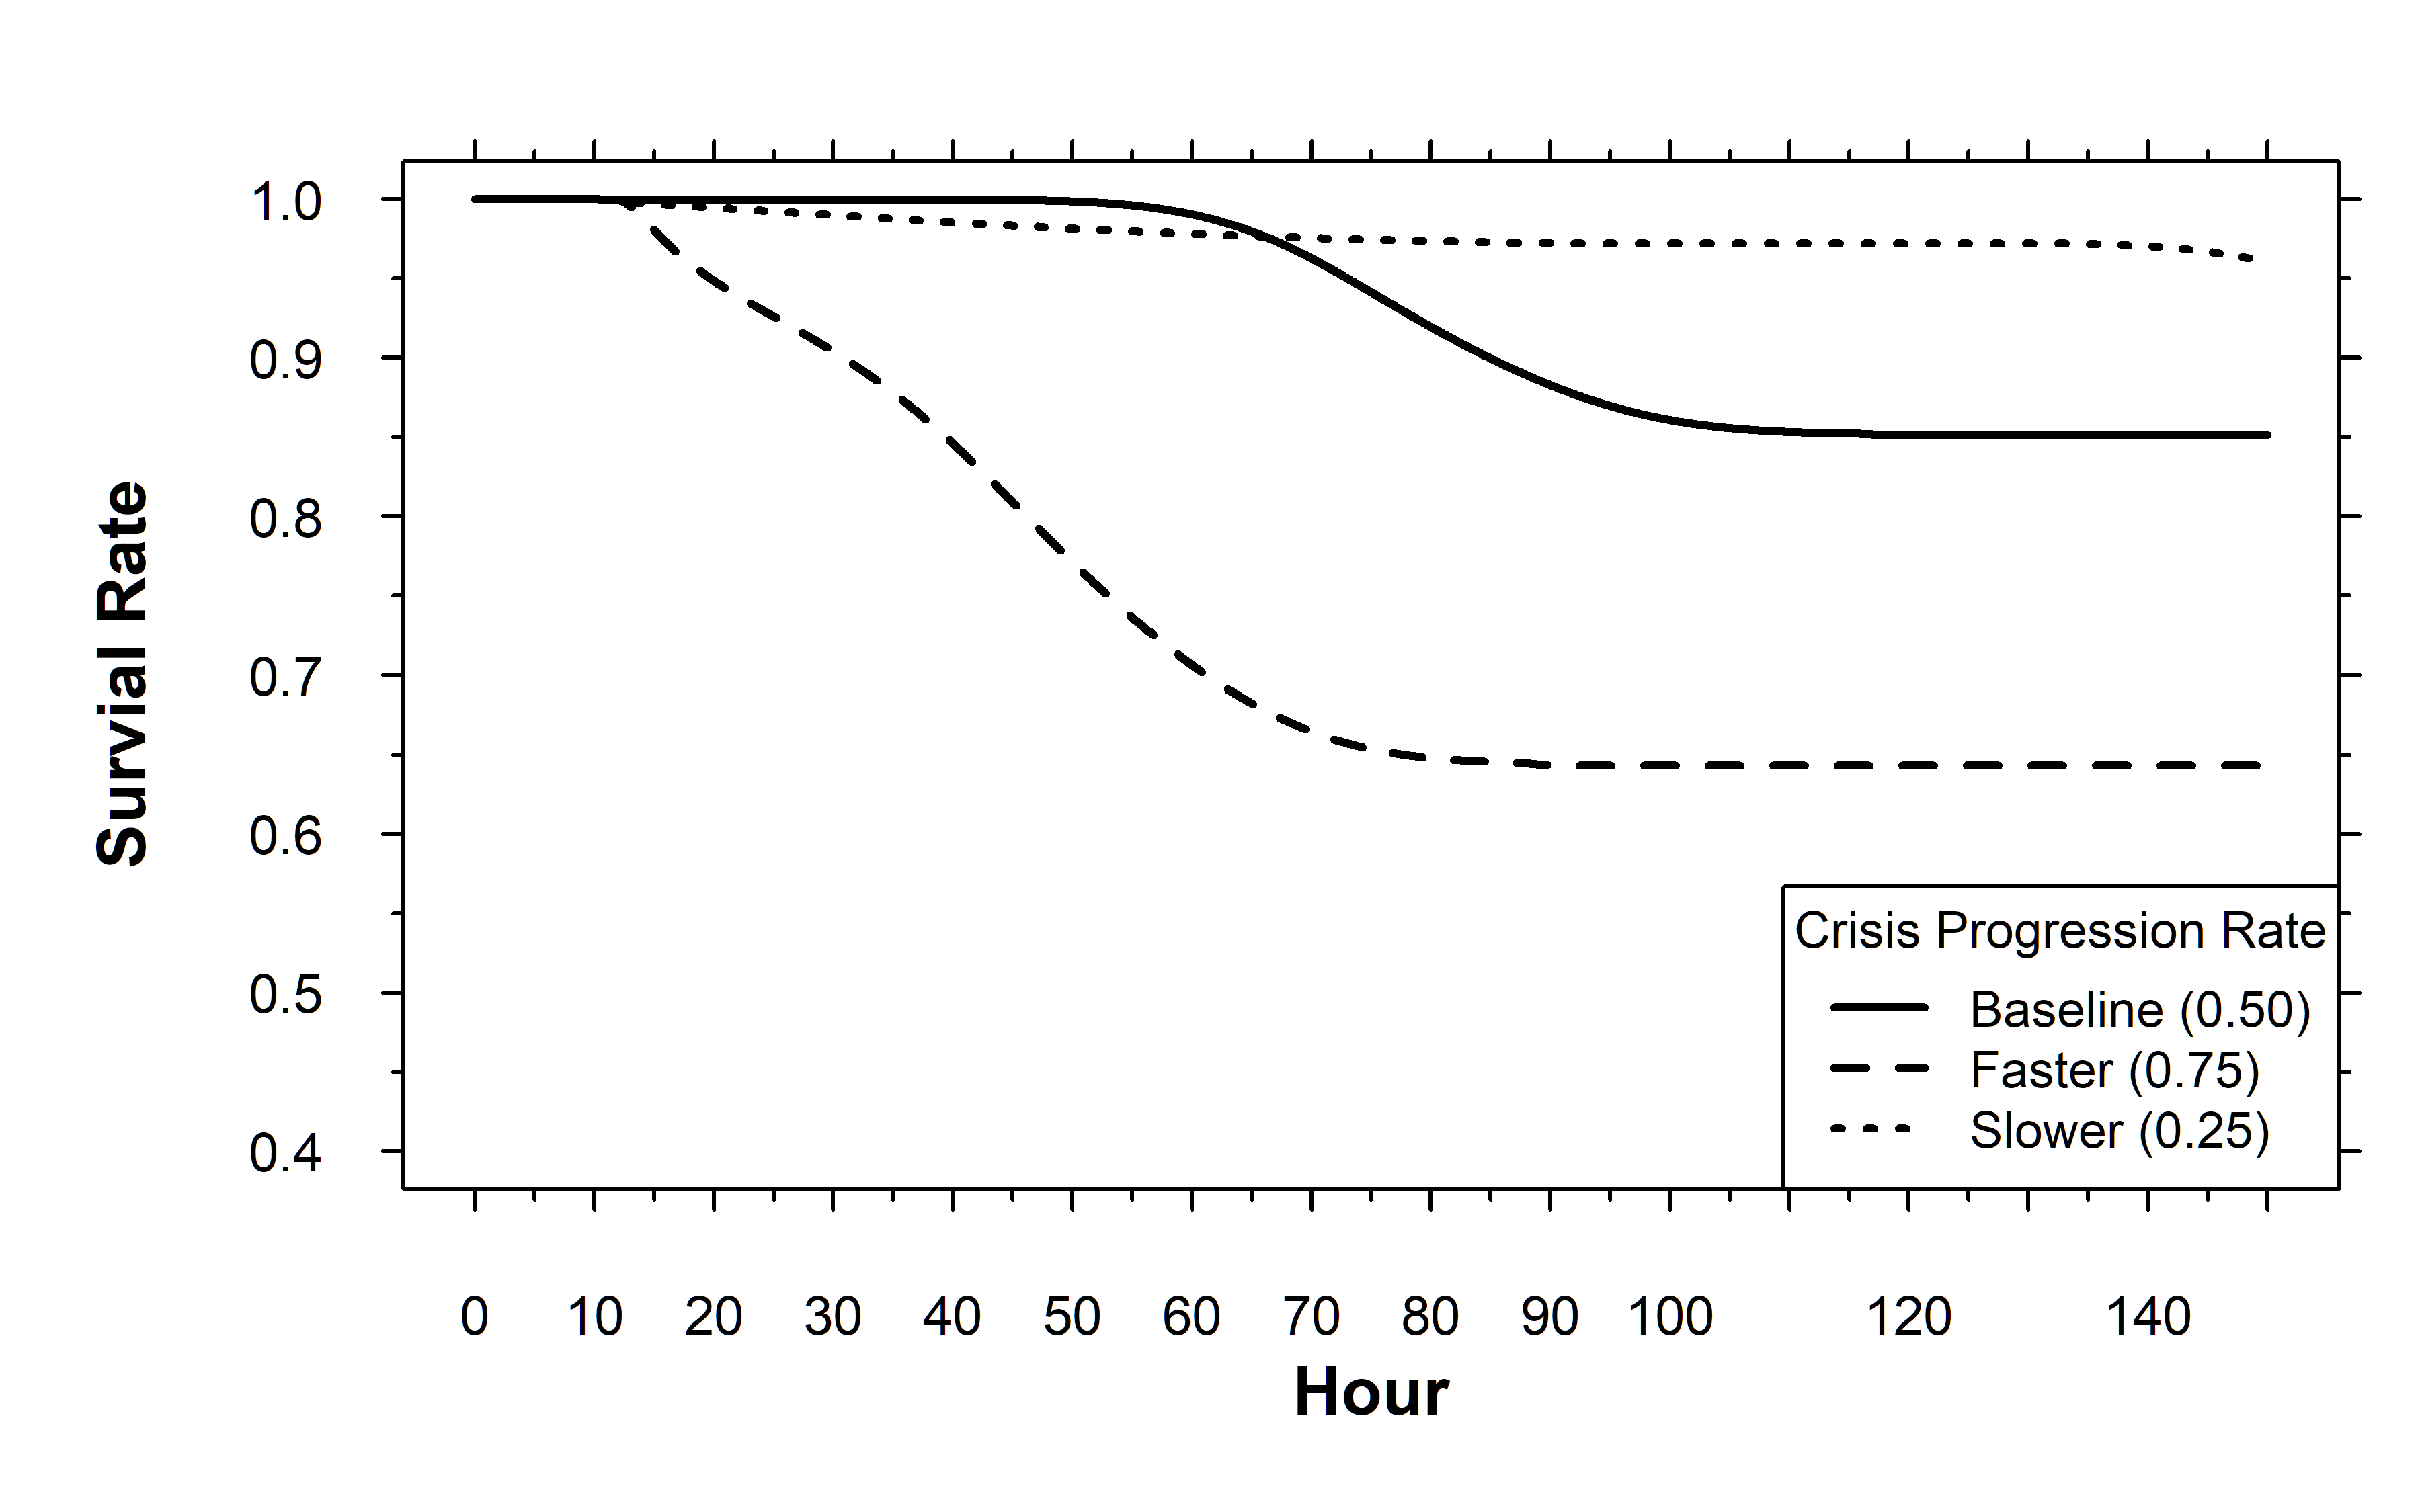
Varying Crisis Progression Rate
Baseline behavior and dynamics is as expected
Rate at which crisis erodes capability largest driver of survival rate

Slide 17
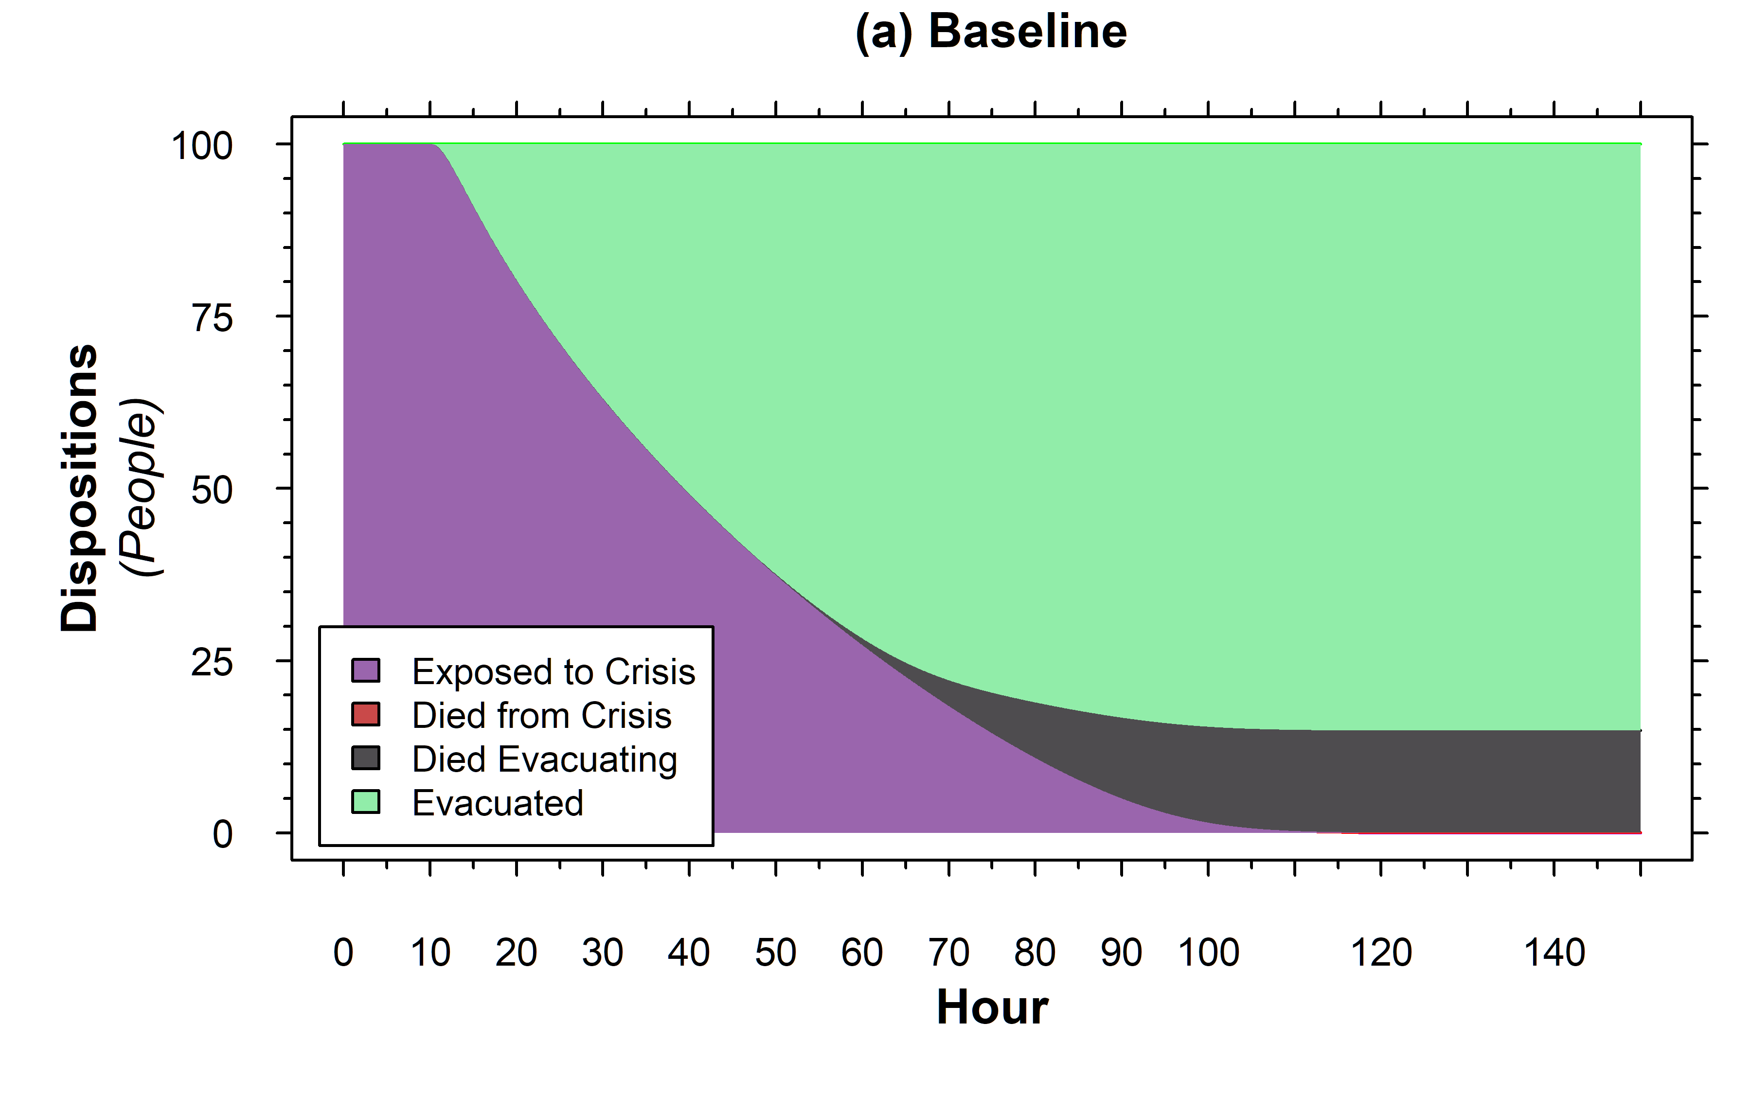
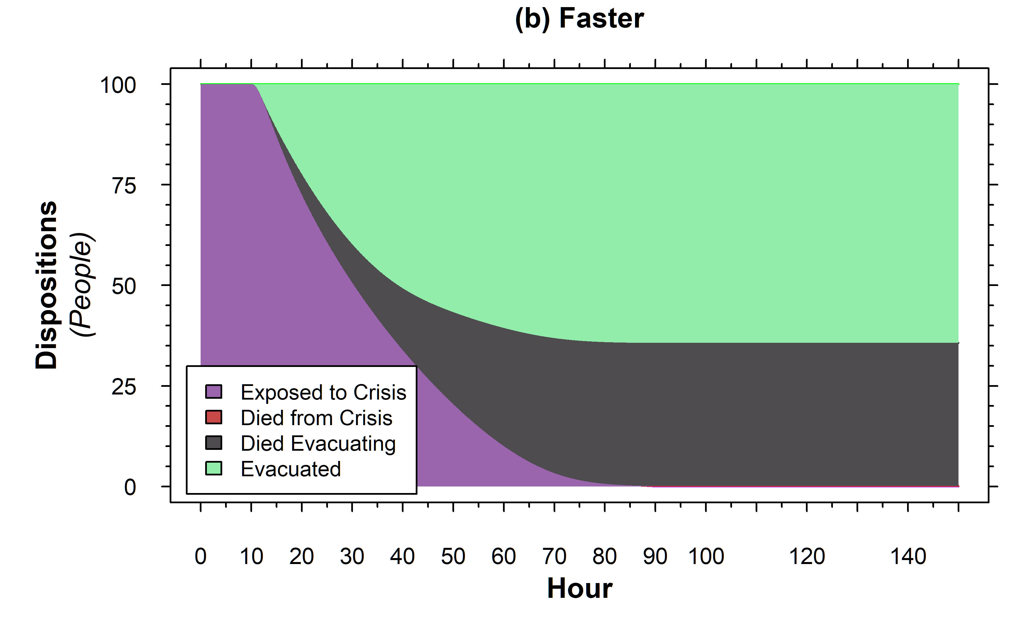
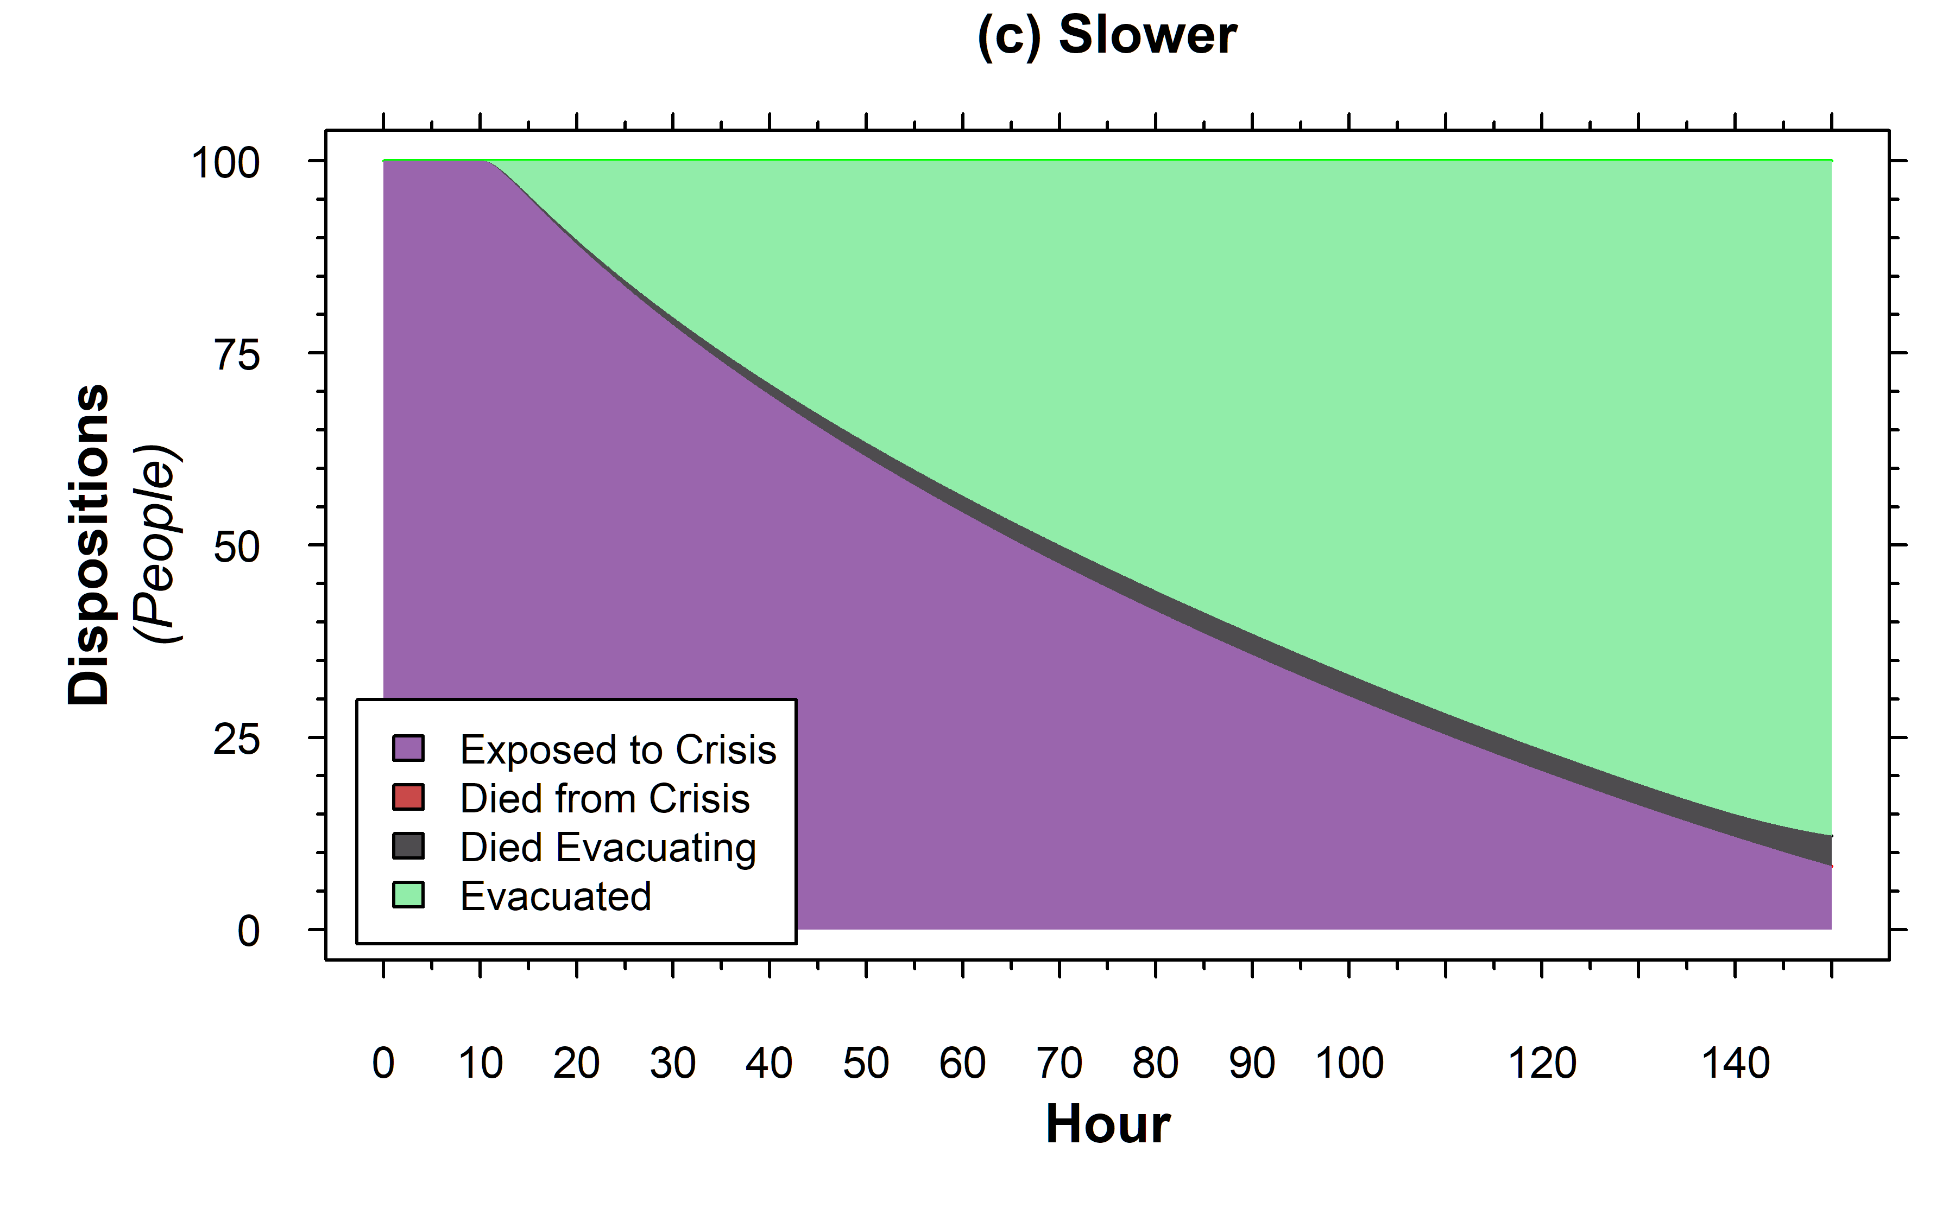
Varying Crisis Progression Rate
Faster erosion leads to quicker response, but also more stress
People evacuate quicker, but eventually at decreasing efficacy

Slide 18
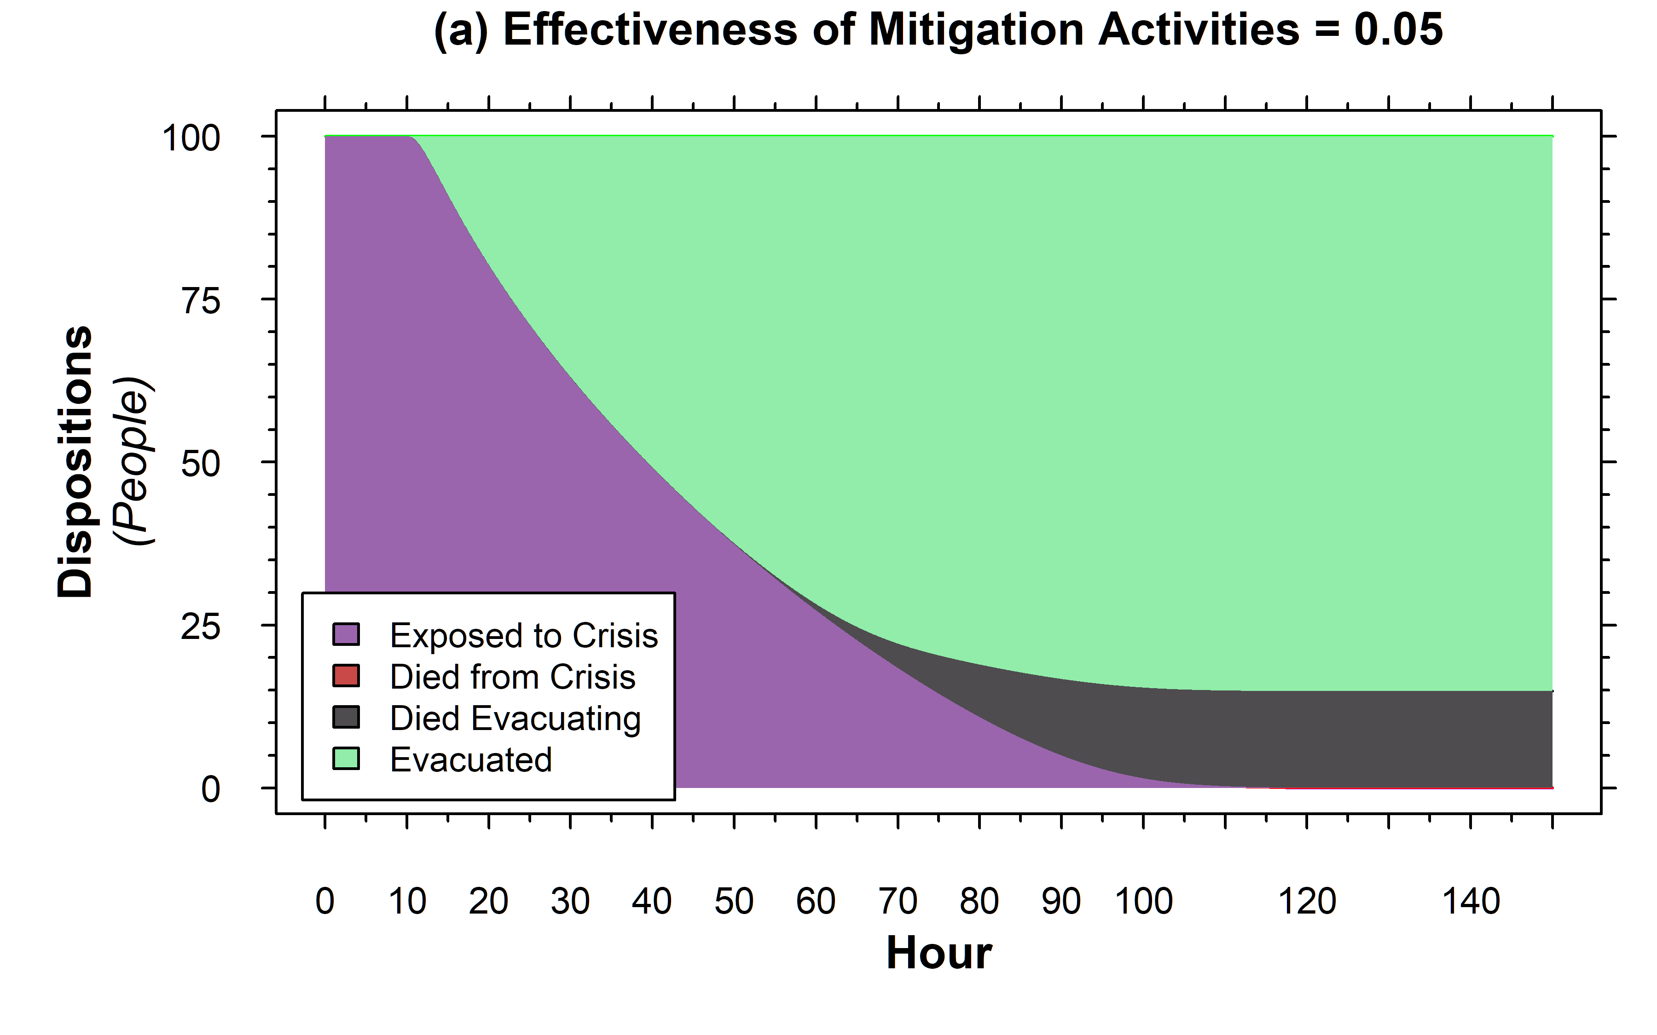
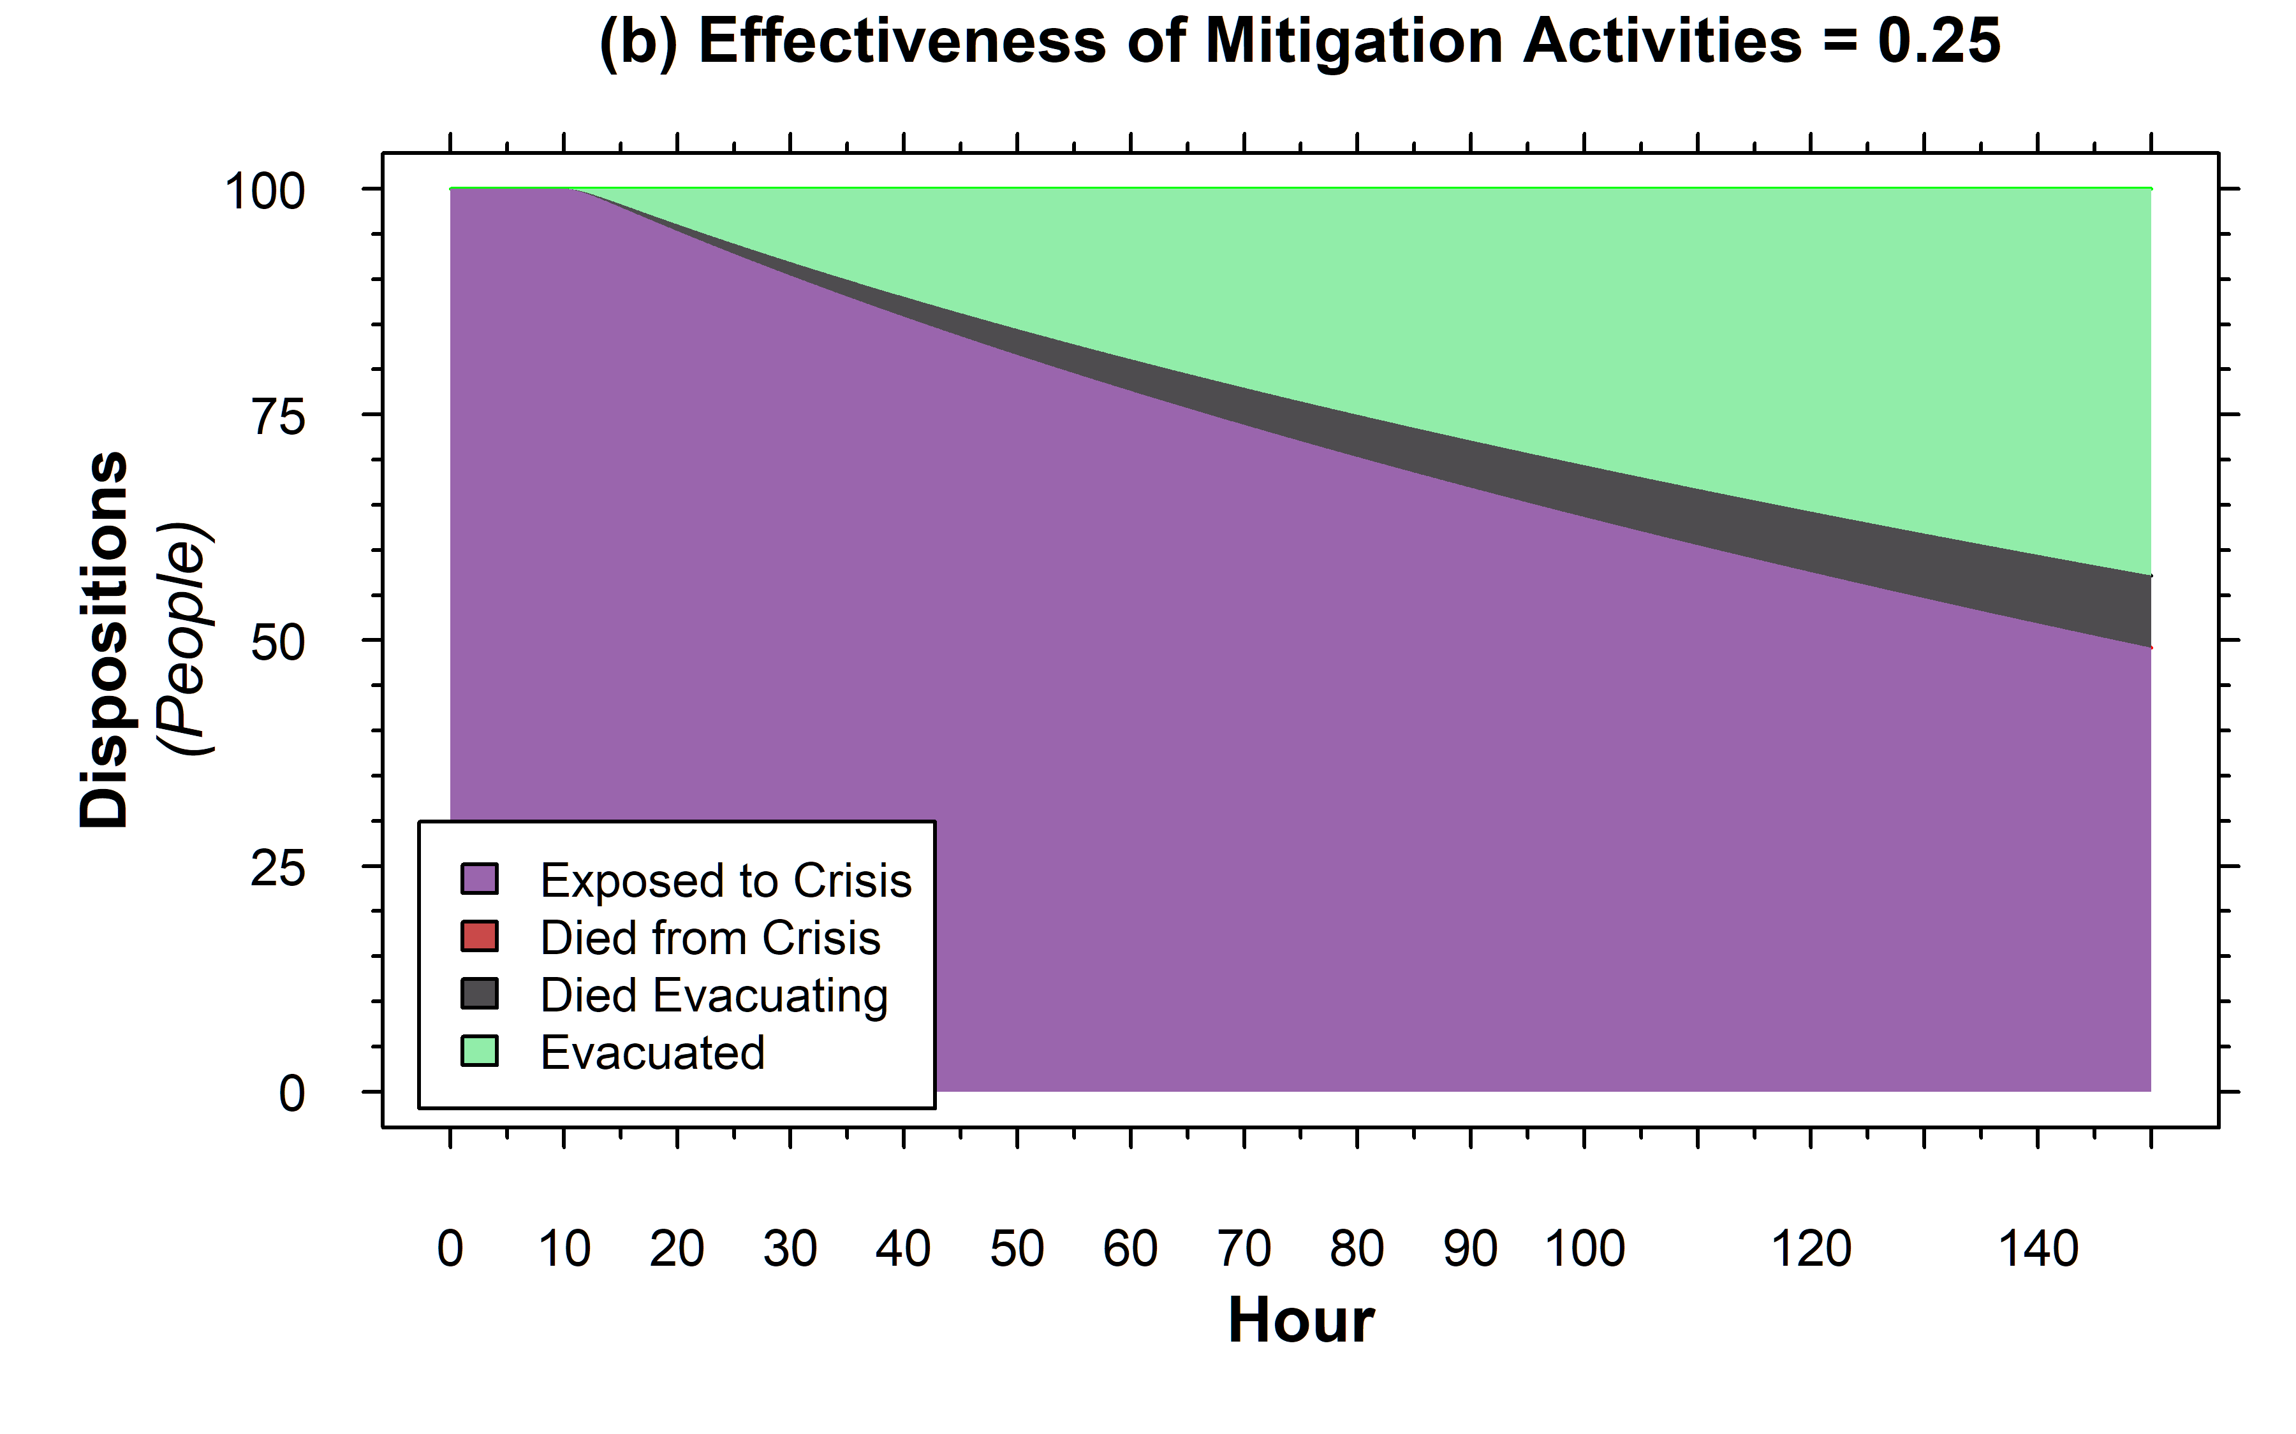
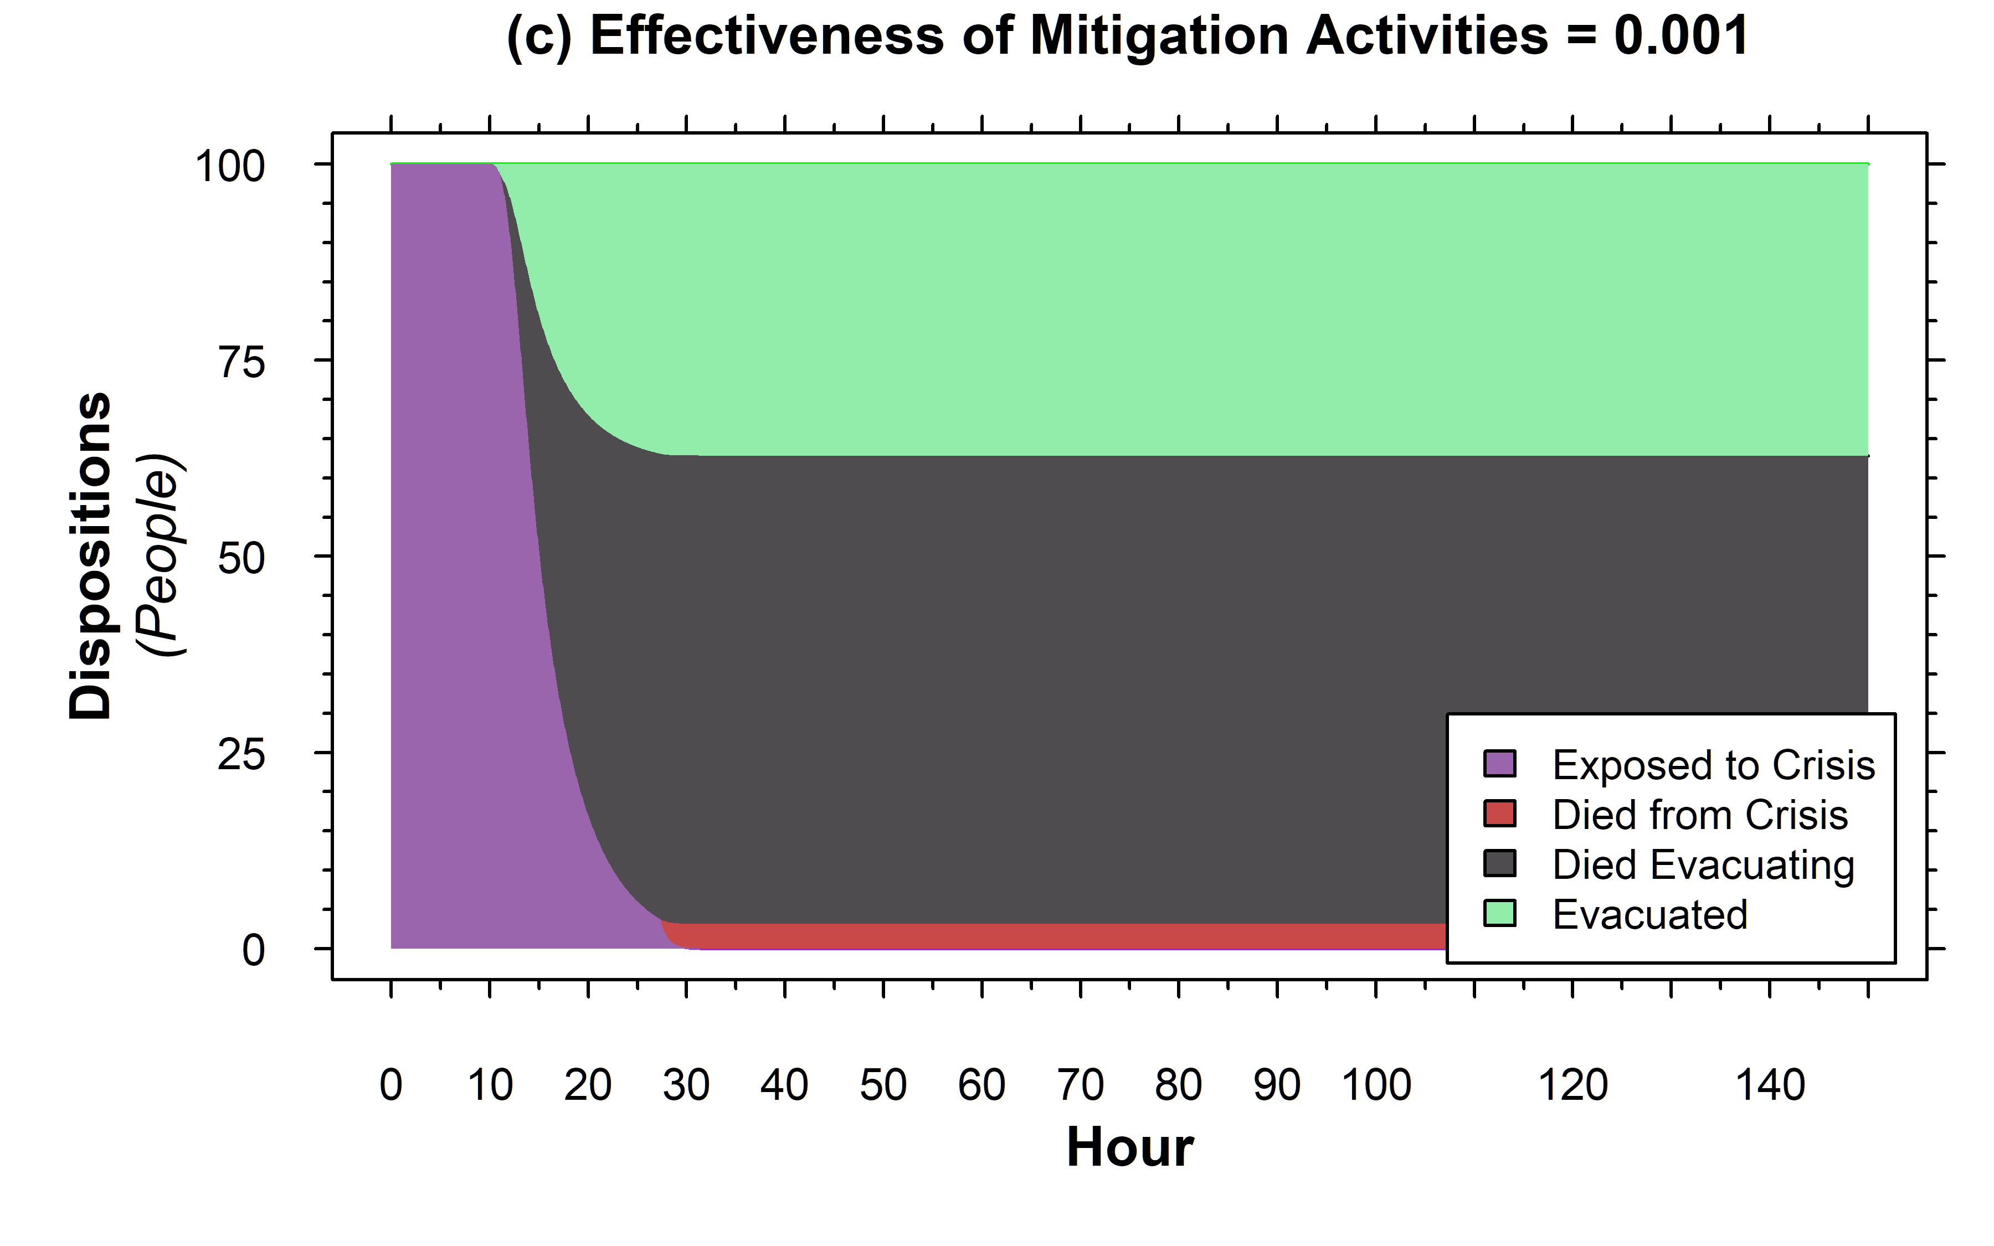
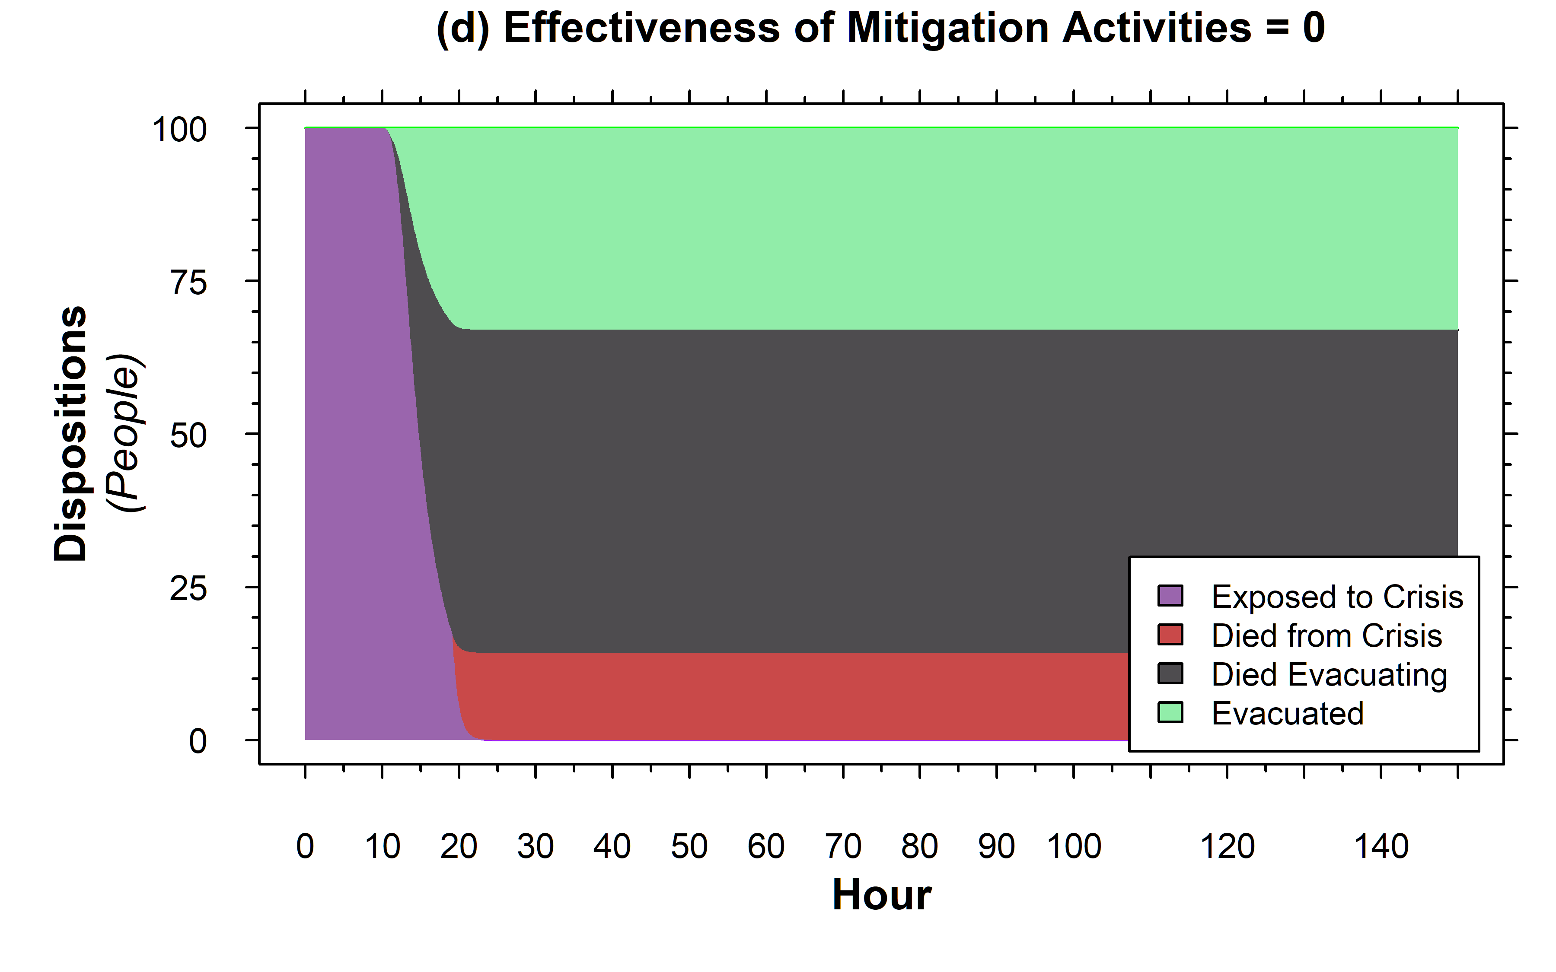
Varying Effectiveness of Mitigation Activities
Less Effective Mitigation leads to quicker evacuation but also more deaths
Totally ineffective mitigation leads to significant deaths from the crisis itself

Slide 19
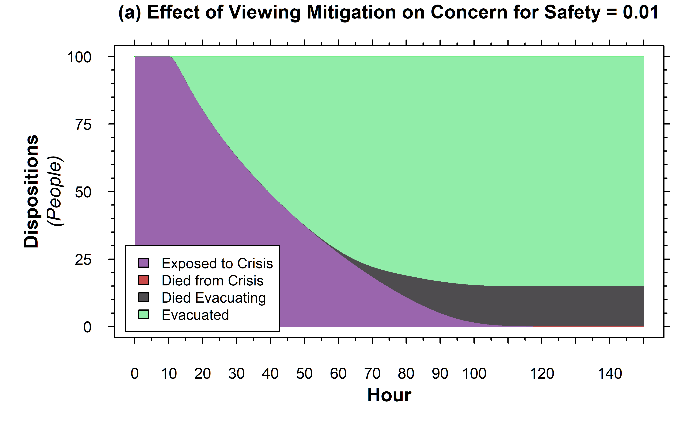
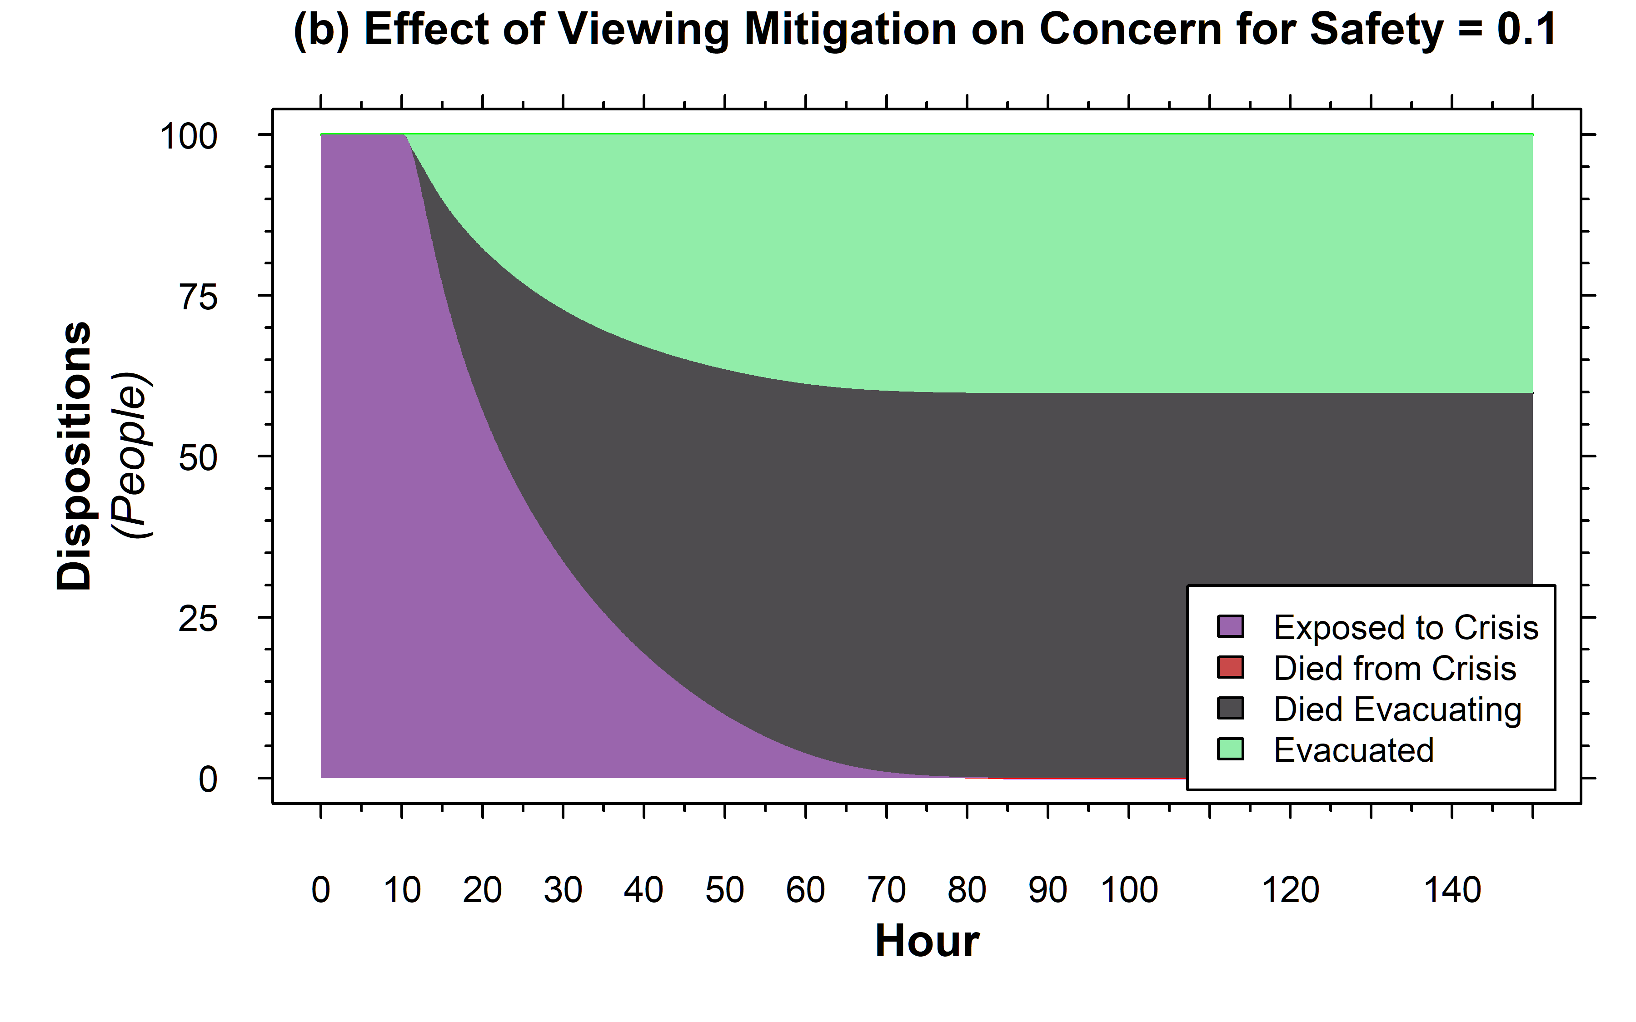
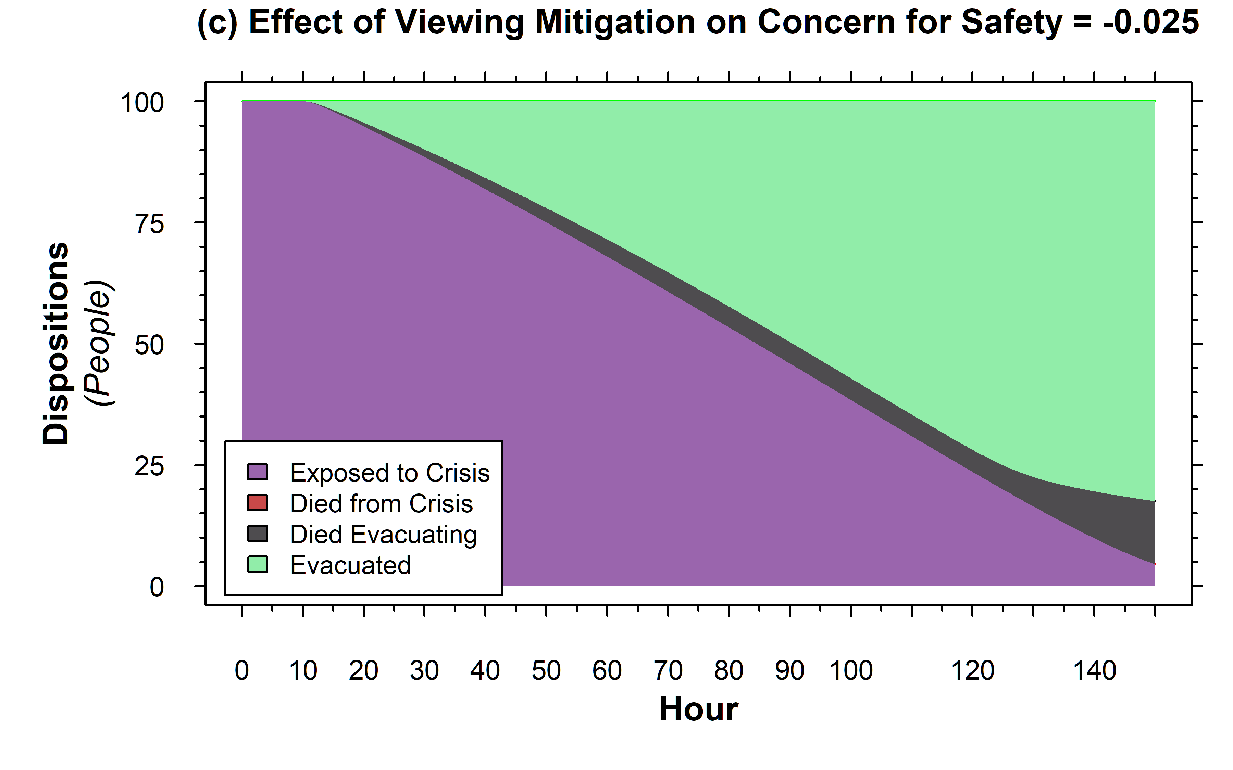
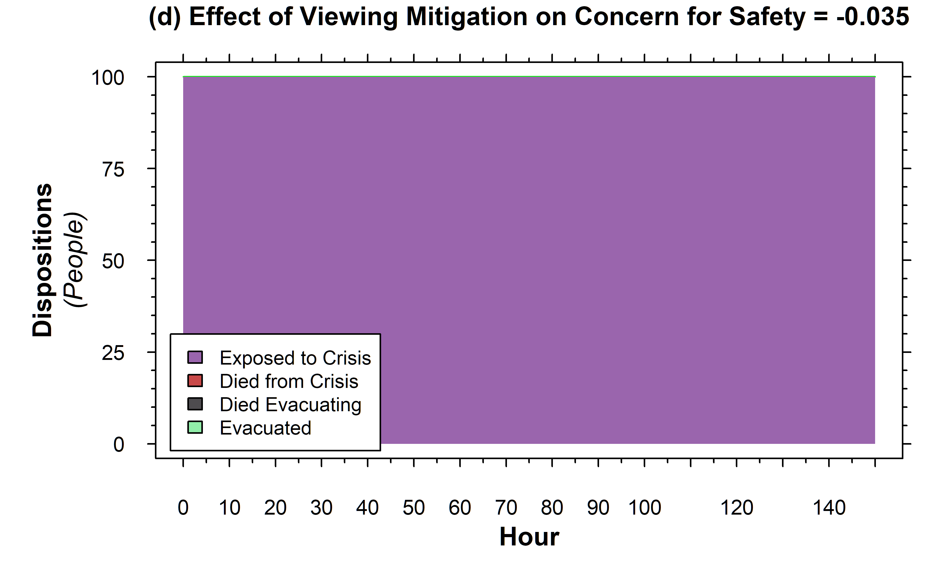
Varying Effect of Viewing Mitigation
More stressful mitigation means faster evacuation, but often less efficacious
Calming, but still effective, mitigation can increase evacuation efficaciousness,
…or even allow people to prevent crisis from progressing
Here, people don’t panic and flee, and instead spend effort maintaining system capability

Slide 20
Varying Effect of Viewing Mitigation
Effectiveness of Mitigation Activities | 0.05 | Dmnl/Activity
…but what if mitigation is totally ineffective for building capability?

Slide 21
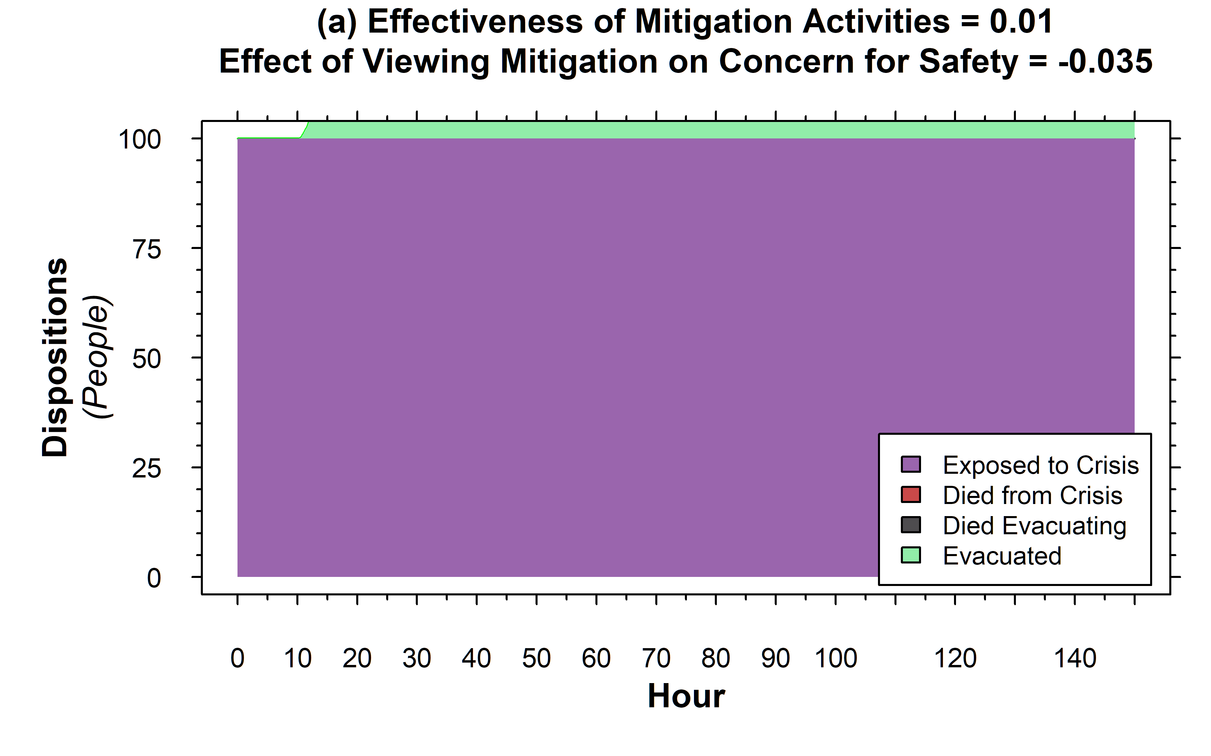
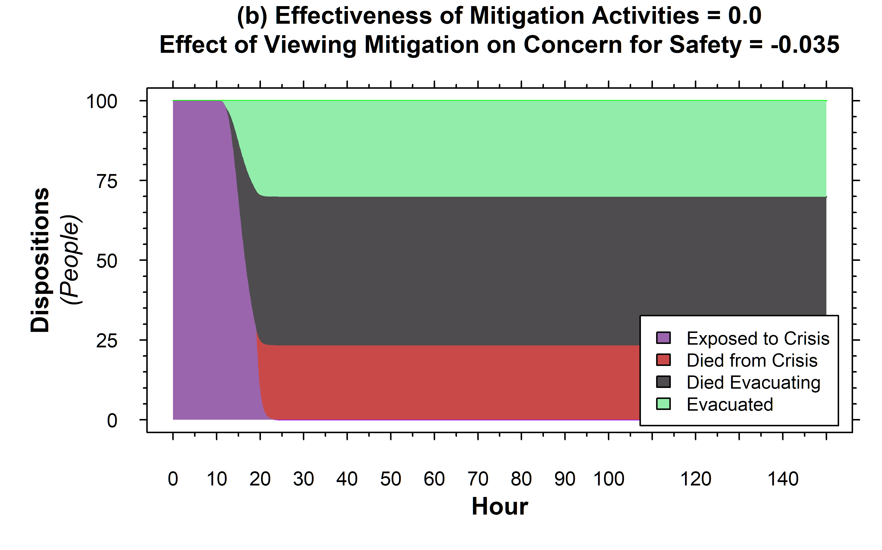
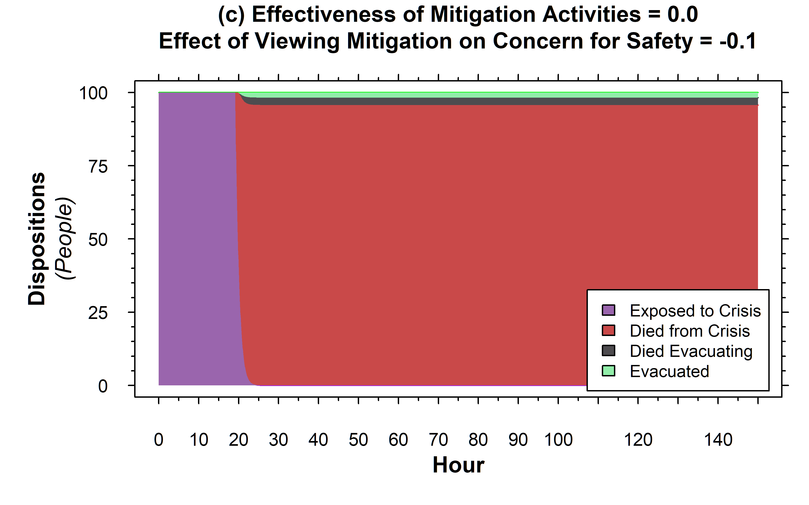
Effect with Totally Ineffective Mitigation
Previous positive effect of calming mitigation lost when mitigation is totally ineffective
For very calming mitigation, can get ‘head in the sand’ outcome with negligible evacuation until it is too late
This is ‘rearranging the deckchairs’

Slide 22
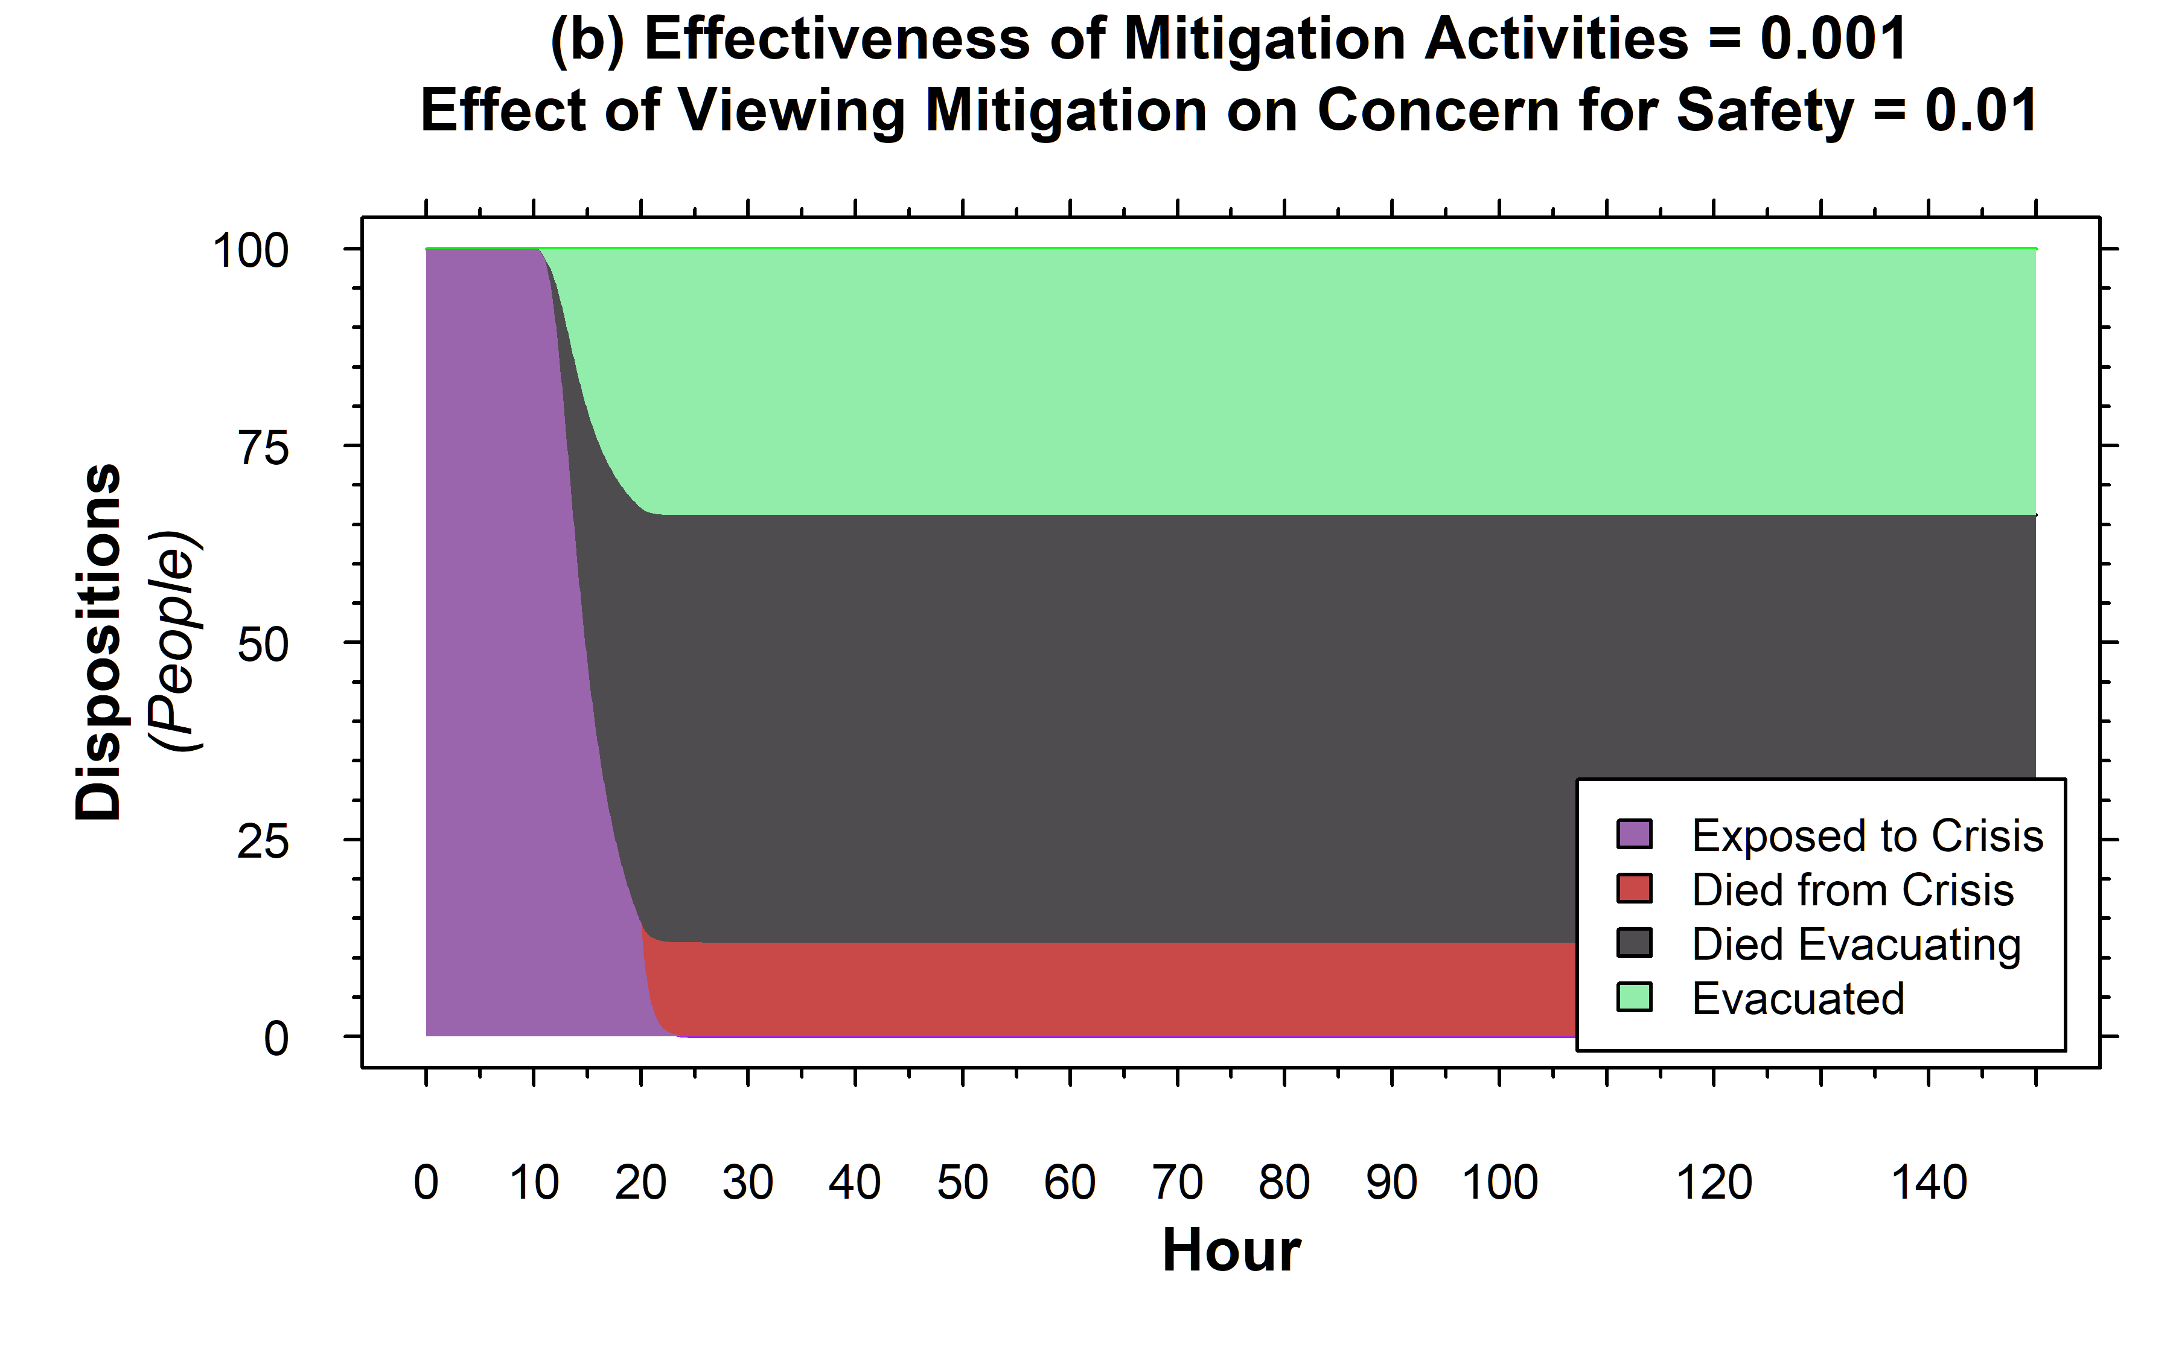

Mitigation must be Marginally Effective
For even marginally effective mitigation, calming can be helpful

Slide 23
Additional Thoughts
Dynamic outcomes are a function of physics and behavioral mechanisms
Physics largely ignored in this quick analysis, focus on behavioral features
Mitigation activities can have two purposes: buying time and calming people down
But, if too calm, then can ignore the problem at hand and before long its too late
Raises practical question: how to identify real effective vs ineffective mitigation?

Slide 24
Additional Backup Slides

Slide 25
Full Model by Itself with Embedded .mdl

Slide 26
Prior Week V1 Behavioral Model by itself

Slide 27
Prior Week Abandoned Physical Model by itself

Slide 28
Week 2 Model

Slide 29
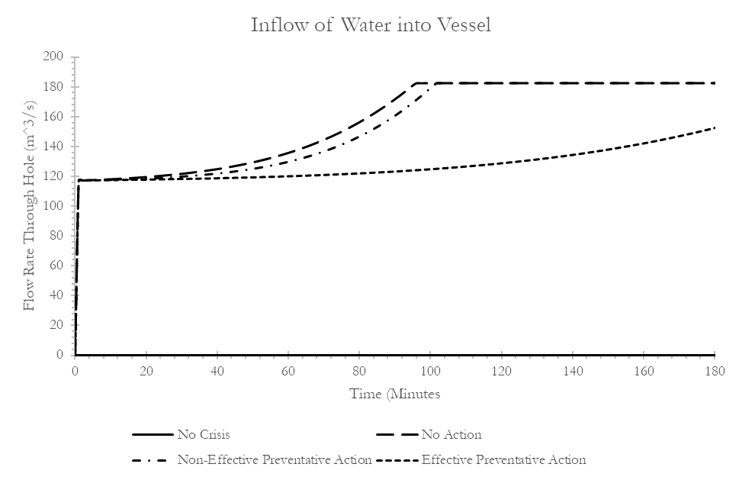
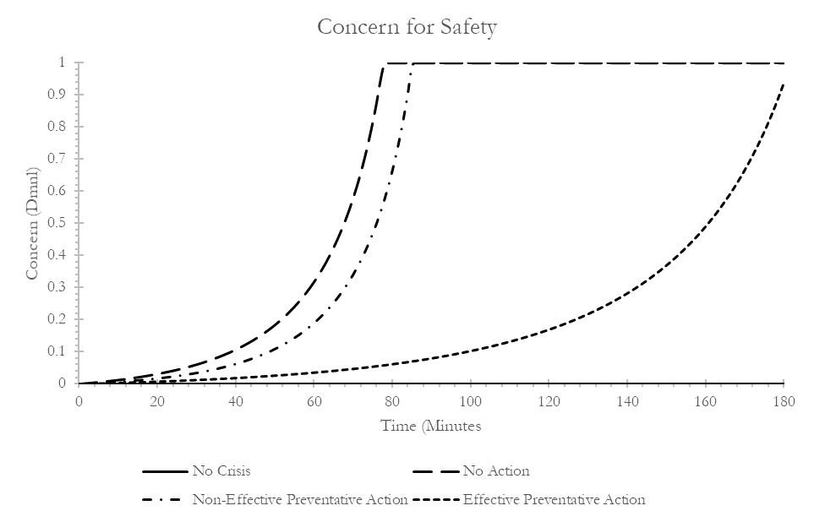

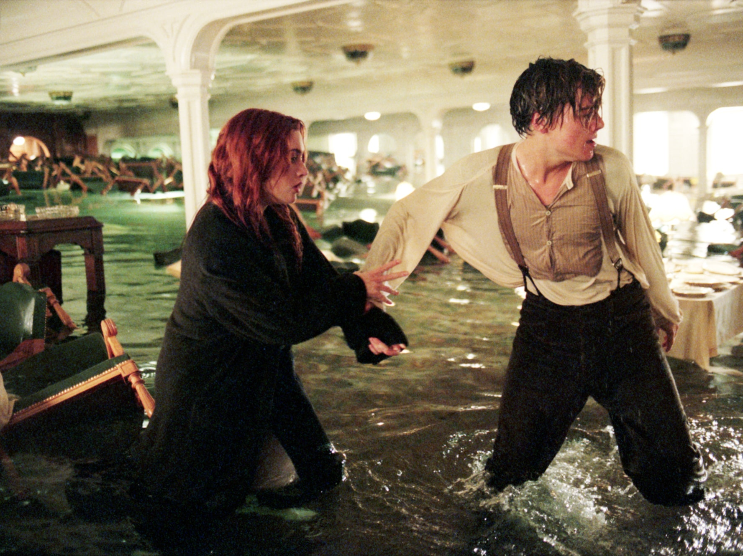
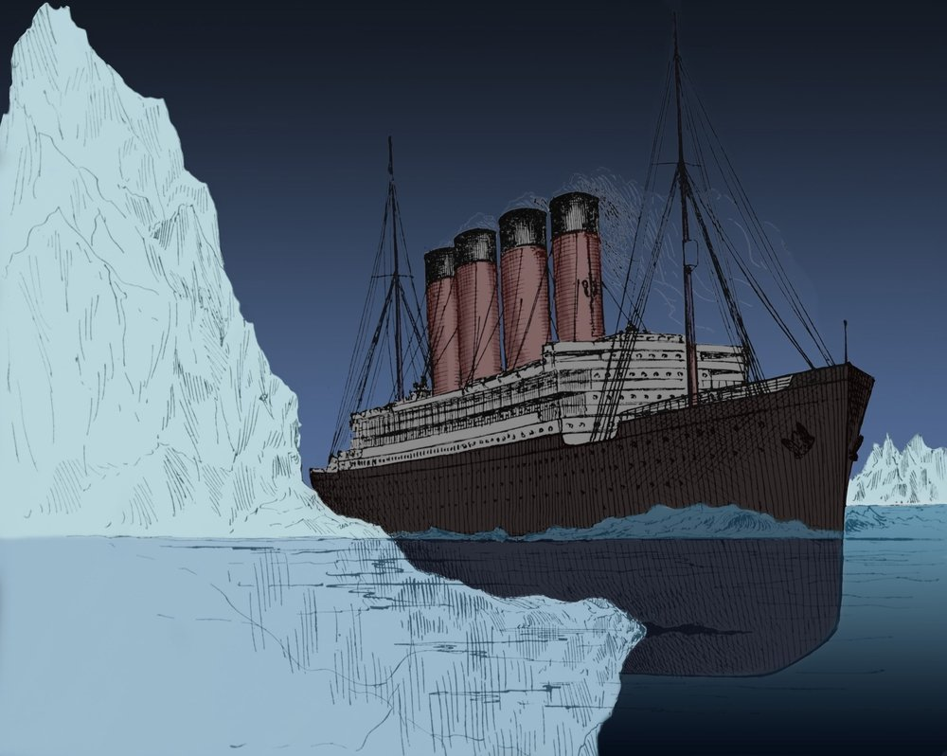
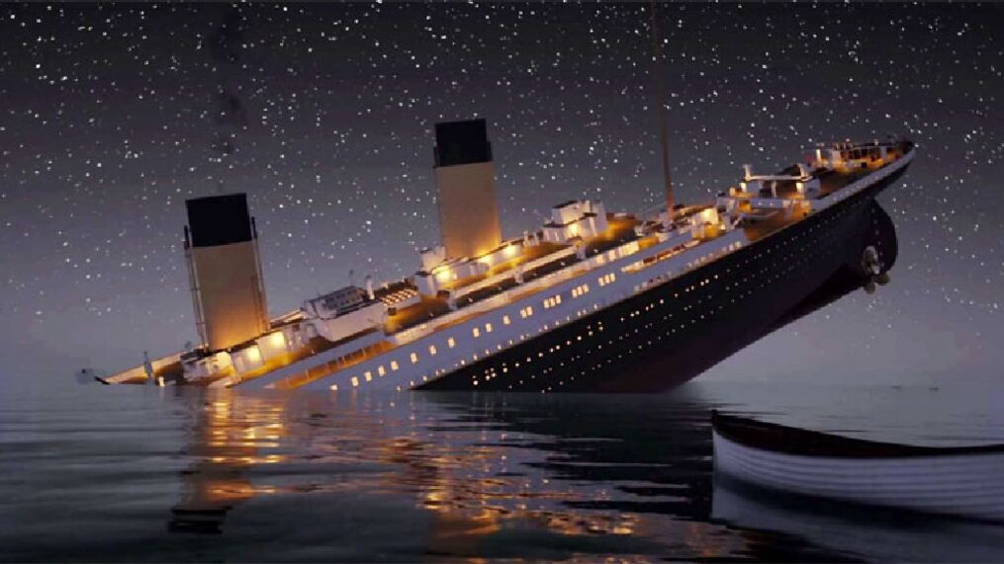
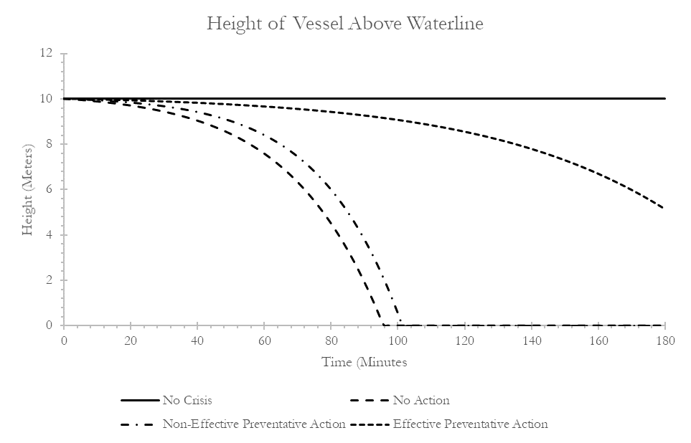
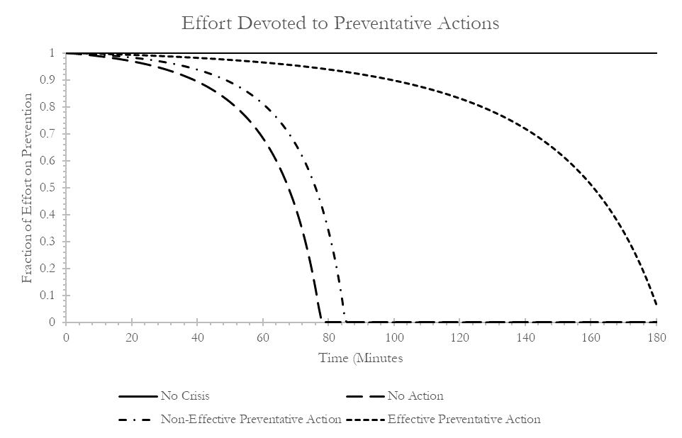
Original Reference Modes (Grounded in Titanic Example)
Notes:
Possible to abstract away from that into a continuous model? Small slight of hand here (y-axis changes)

